Slide 1
DATA:
from OWN-ROOTED PLANTS
Biometric measures at shoot level (diameter, length, number of nodes) of 1 year old shoots (parent);
Qualitative measures at node level (type of bud/sylleptic (M= mixed, C=catkin, V=vegetative, B=blind) of the same 1 year old shoots
120 1-year-old shoots sampled January 2020;
120 1-year-old shoots measured January 2020;
104 2-year-old shoots measured January 2021
Biometric measures at shoot level (diameter, length, number of nodes) of 1 year old shoots (child) born from the parerent;
Qualitative measures at node level (type of bud/sylleptic (M= mixed, C=catkin, V=vegetative, B=blind) of the same child shoots
Same labels were lost during 2020
GOALS:
The model of my dreams should answer those questions:
How 1 yeard old shoot is composed?
There are some zones of the same type of bud?
There are difference in composition according to the length of the shoot?
How is the behavior of lateral shoots?
How many of them developed?
Where?
From which bud? (vegetative or mixed?)
how can we deal with multiple buds and multiple lateral shoots per node?
This problems cold be solved analysing the data:
From different point of views
Shoot scale
Metamer scale
Bud scale
With different tecniques:
exploratory analysis
Glms

Slide 2
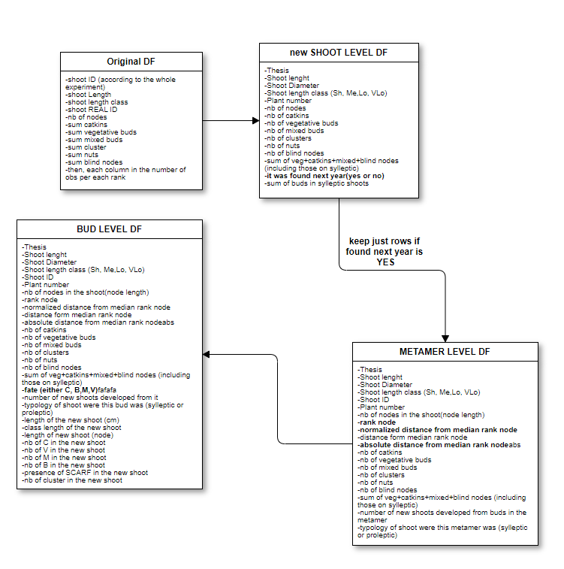
Dataset trasnformation
Problems:
The original DF was at shoot scale,
Each column was a rank;
Sylleptic shoots were not considered because their existence wes ignored
Solutions:
Create two other df either for bud scale or metamer scale,
Each column should be the nb_ of each fate;
Infer sylleptic shoots by the presence of catkins
Process
ALL the dataframes refers to shootID
that were found into 2021

Slide 3
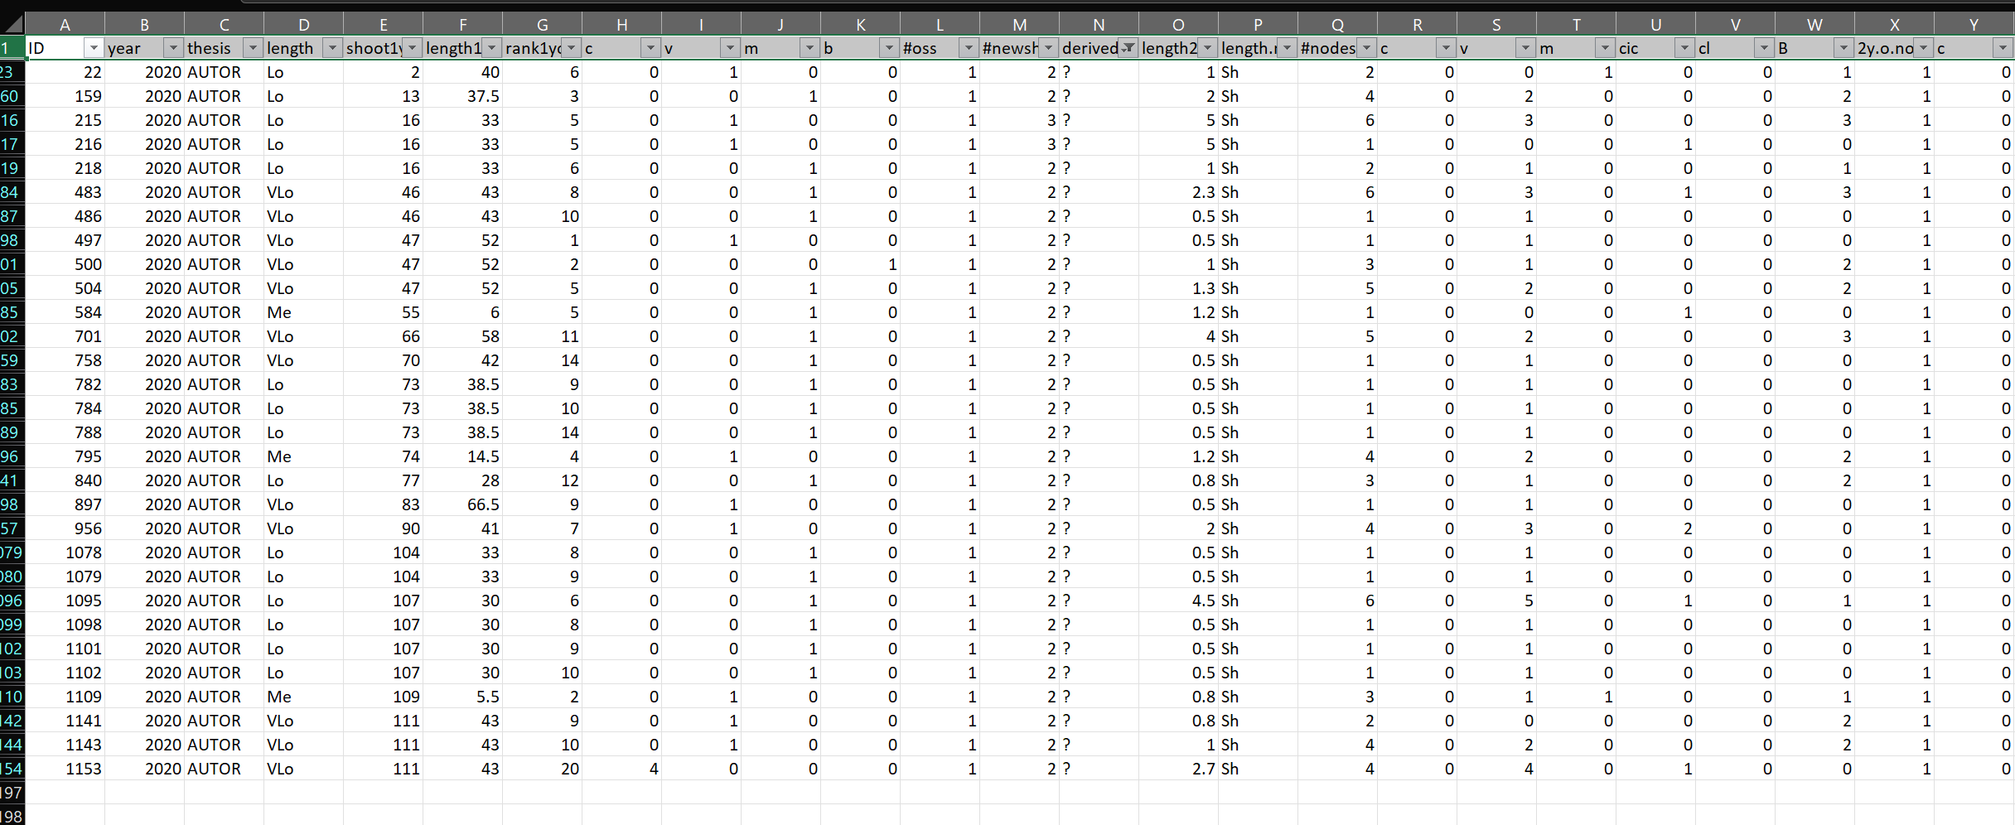
The original «new_shoots» file has the same information of the bud fate scale(in terms of new shoots details) plus it contains some the errors.
Errors= new shoots that i can’t explain from where they came from. Assigned as «?»
These errors impact less than 3% on the totals, so i guess we can ignore them and use the bud_scale file also for new shoots. What do you thing?

Slide 4
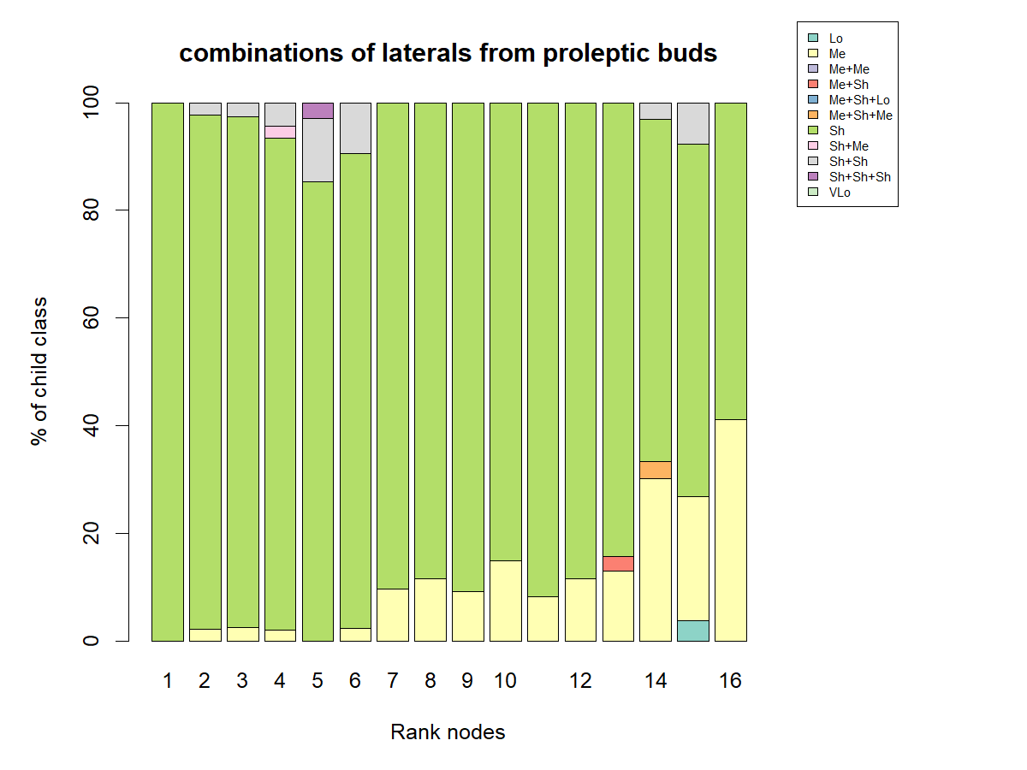
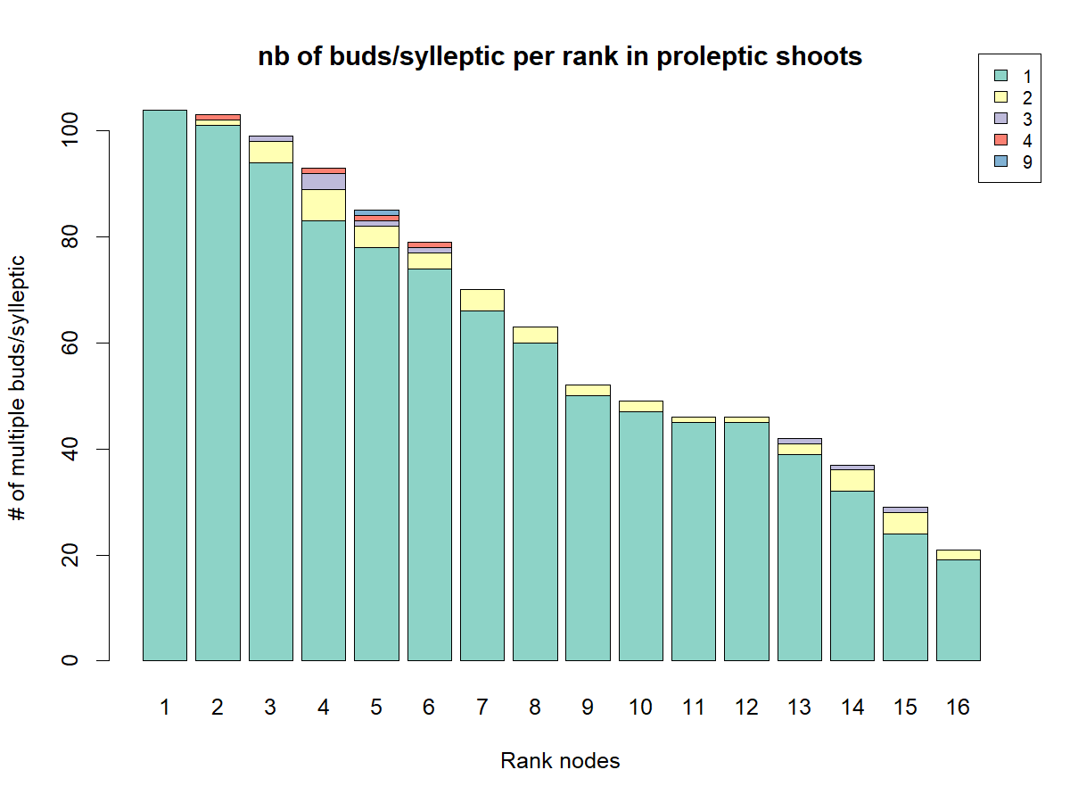
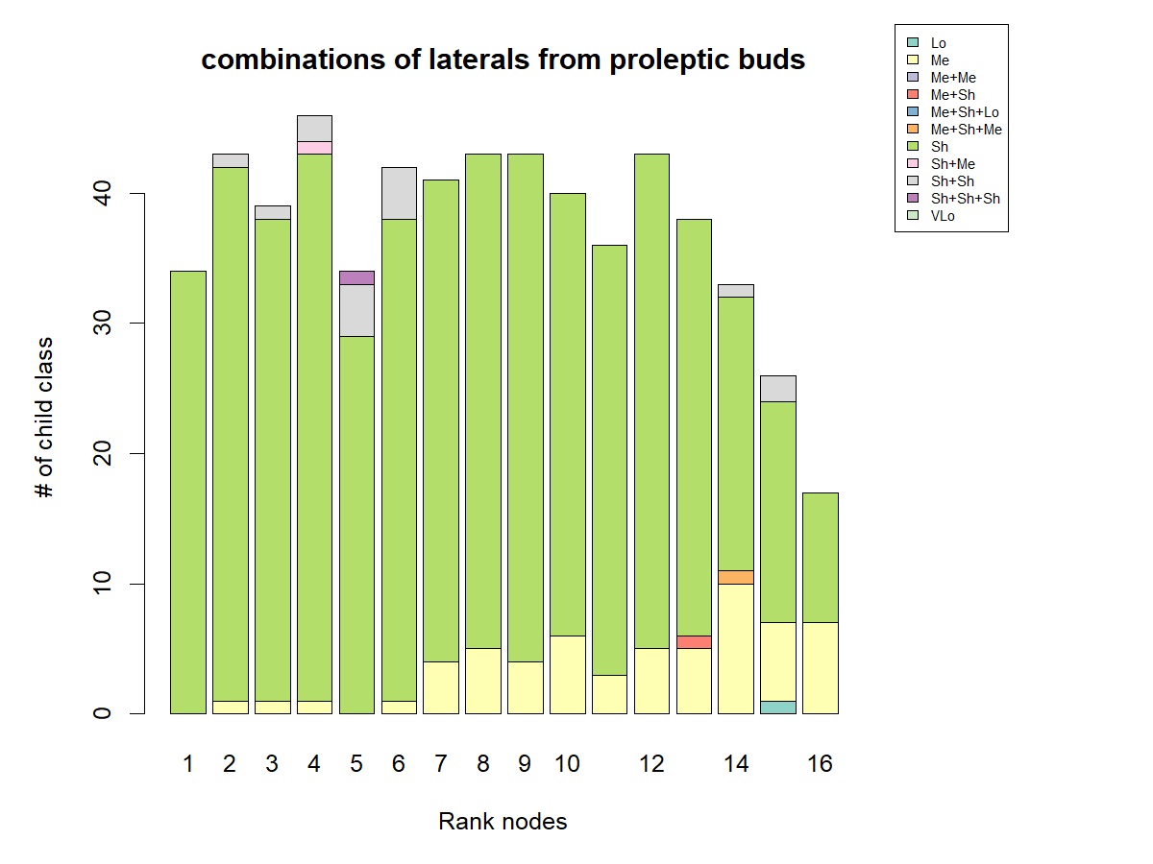
Hazelnut architecture
BUSHY
ACROTONIC AT SHOOT LEVEL
BASITONIC AT TREE LEVEL
PRESENCE OF MALE FLOWERS JUST IN SYLLEPTIC SHOOTS
PRESENCE OF MIXED BUDS THAT WILL GIVE FLOWER AND NUTS
MORE BUDS PER NODE
MORE NEW SHOOTS PER NODE

Slide 5
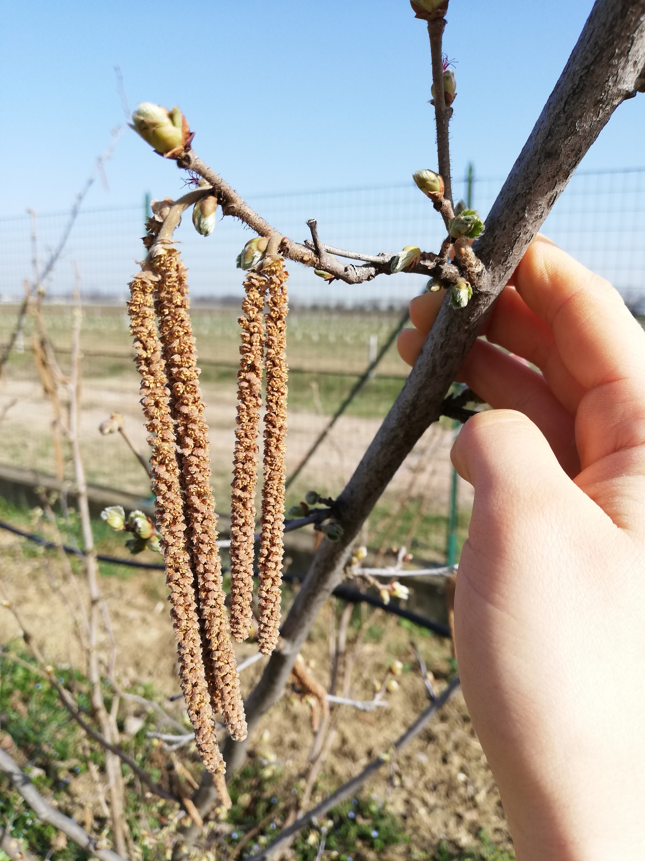
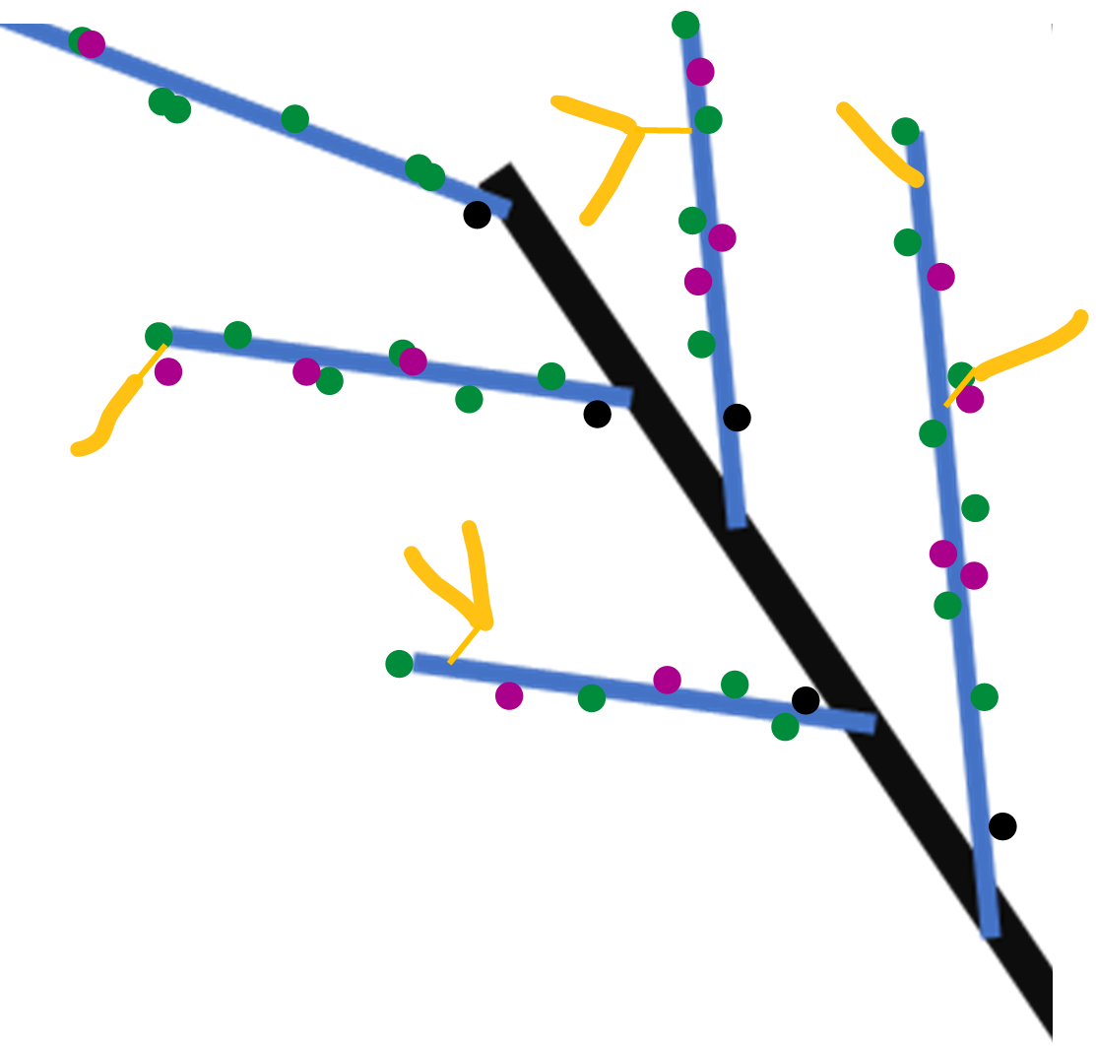
Winter observation
Year n
Year n
Proleptic shoot (referred to black)
Sylleptic shoot (referred to blue)
vegetative bud
Year n-1
Mixed bud
Blind node
catkin
SYLLEPTIC SHOOTS

Slide 6
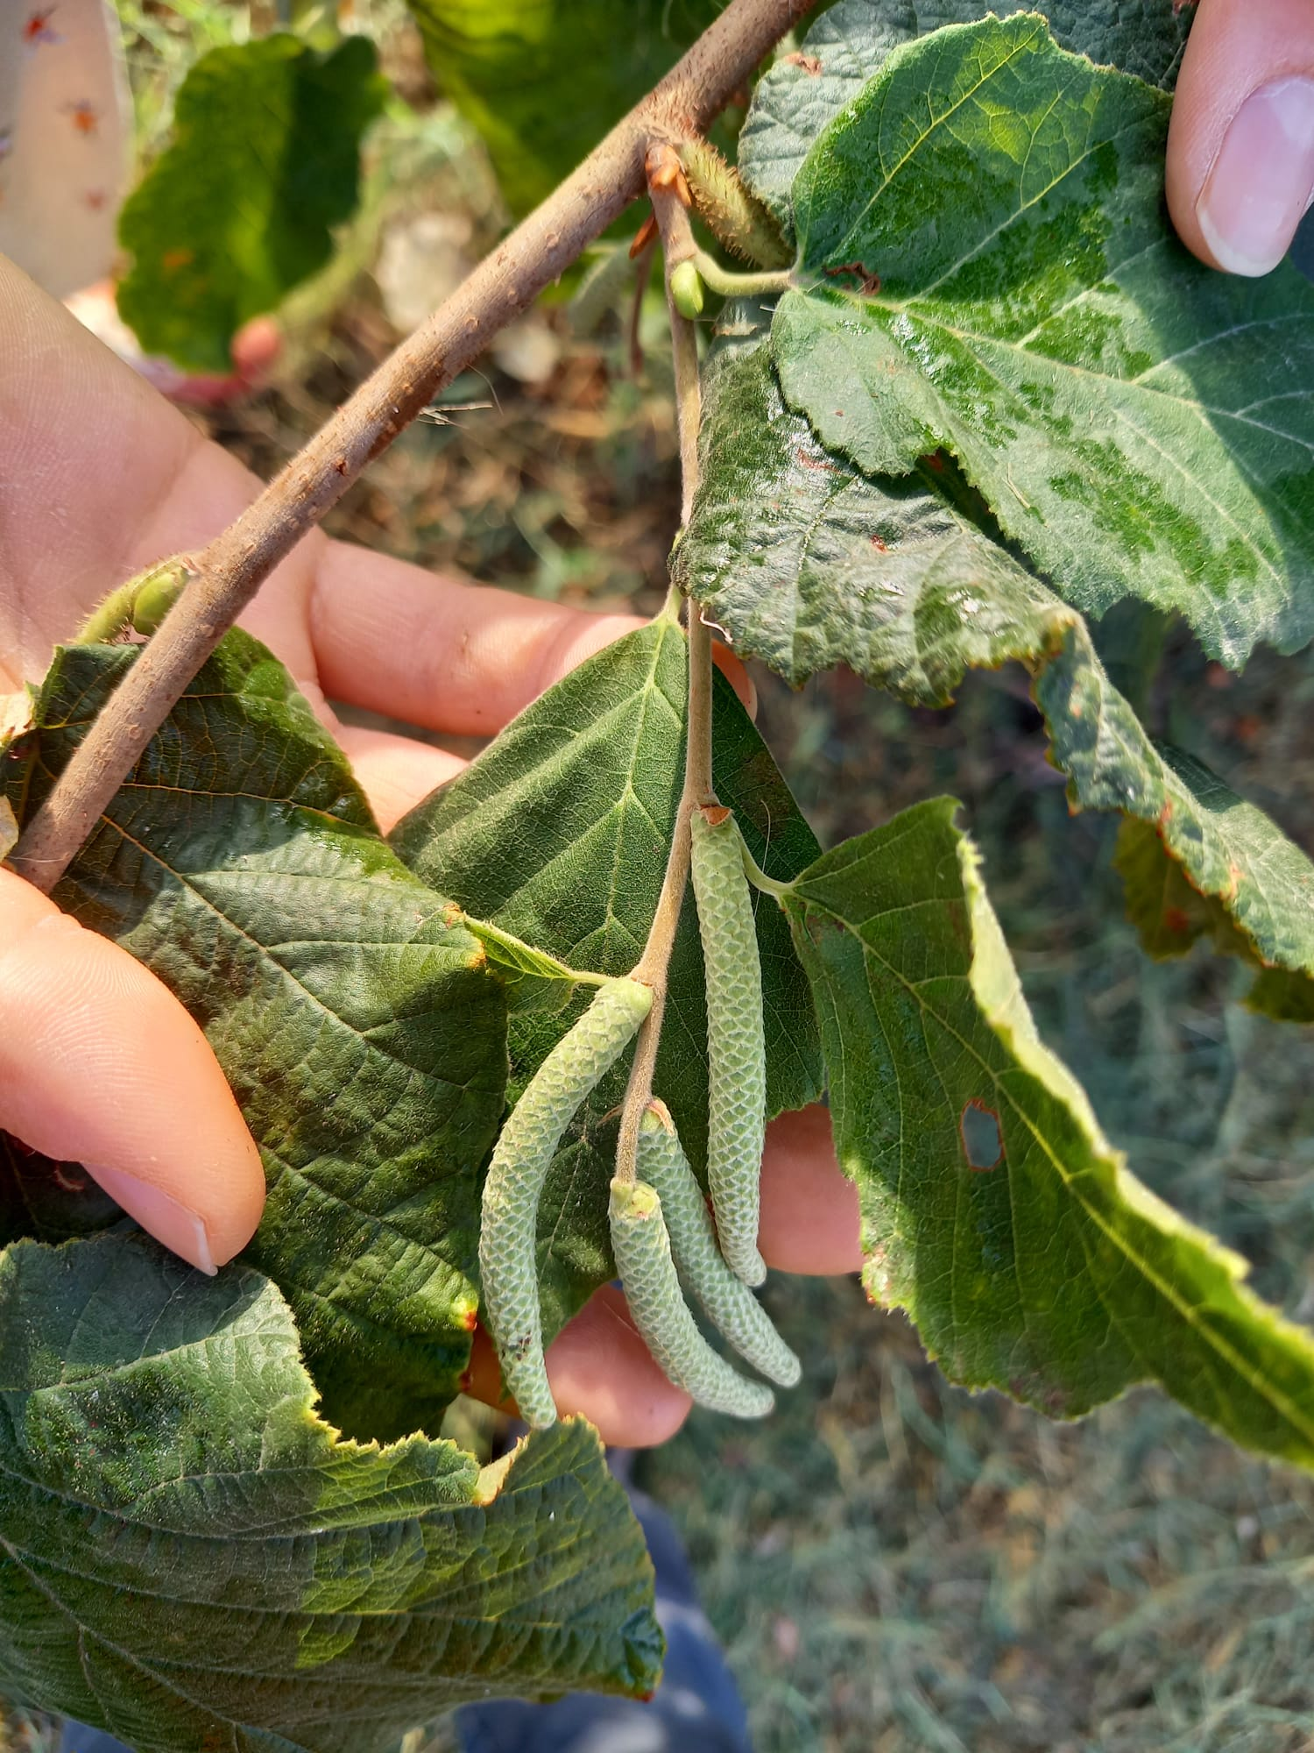
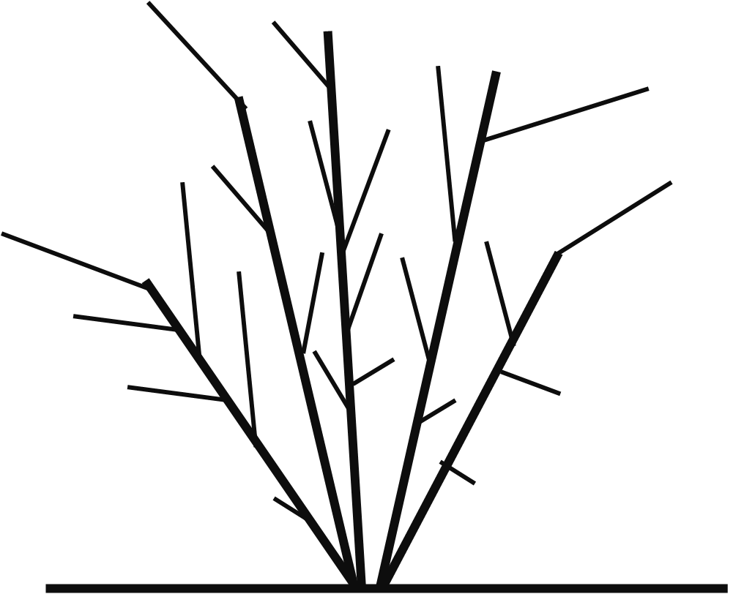
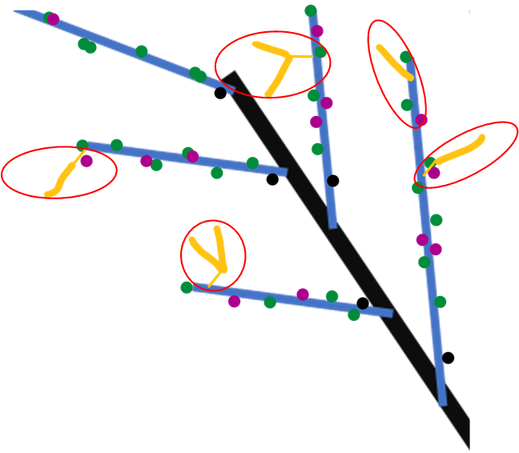

Spring growth
Year n+1
Year n+1
Year n
New proleptic shoot
Year n+1
Year n-1
New sylleptic shoot
Year n+1
leaves
SYLLEPTIC SHOOTS

Slide 7
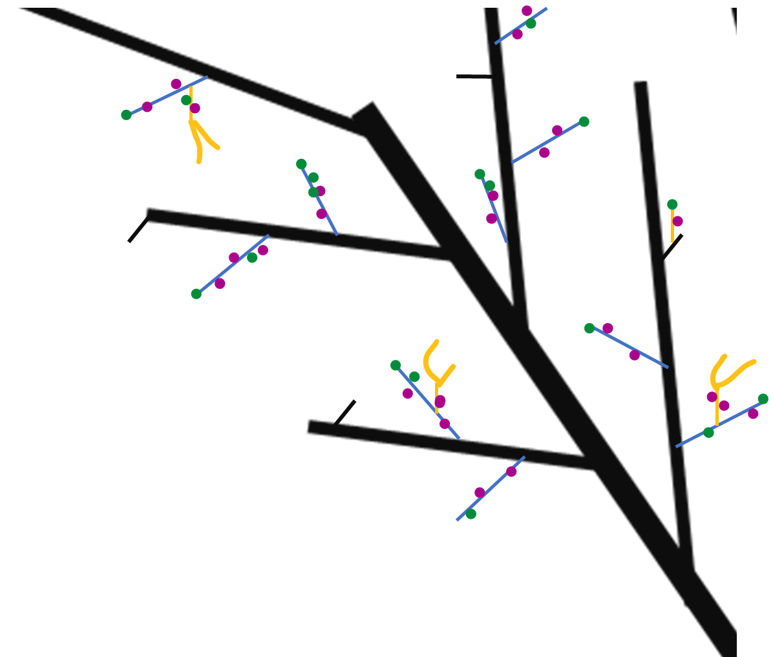
Next winter observations
Year n
Year n
Year n+1
Proleptic shoot
Year n+1
Sylleptic shoot
vegetative bud
Mixed bud
Year n-1
Blind node
catkin
SYLLEPTIC SHOOTS

Slide 8
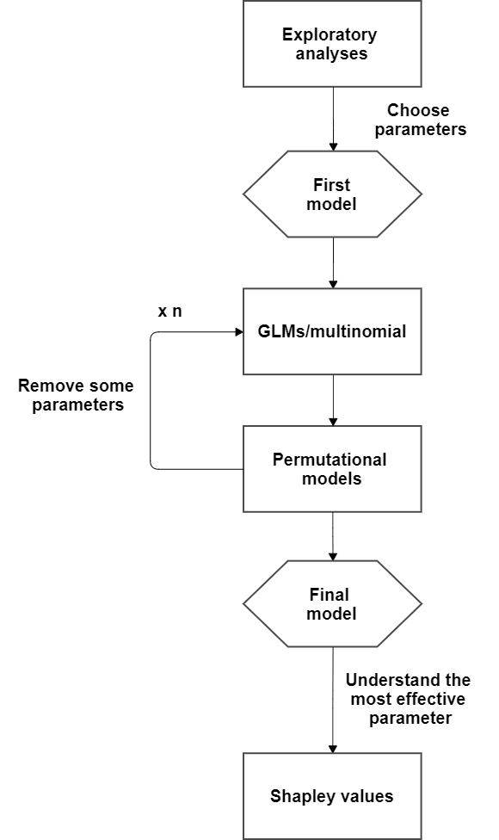
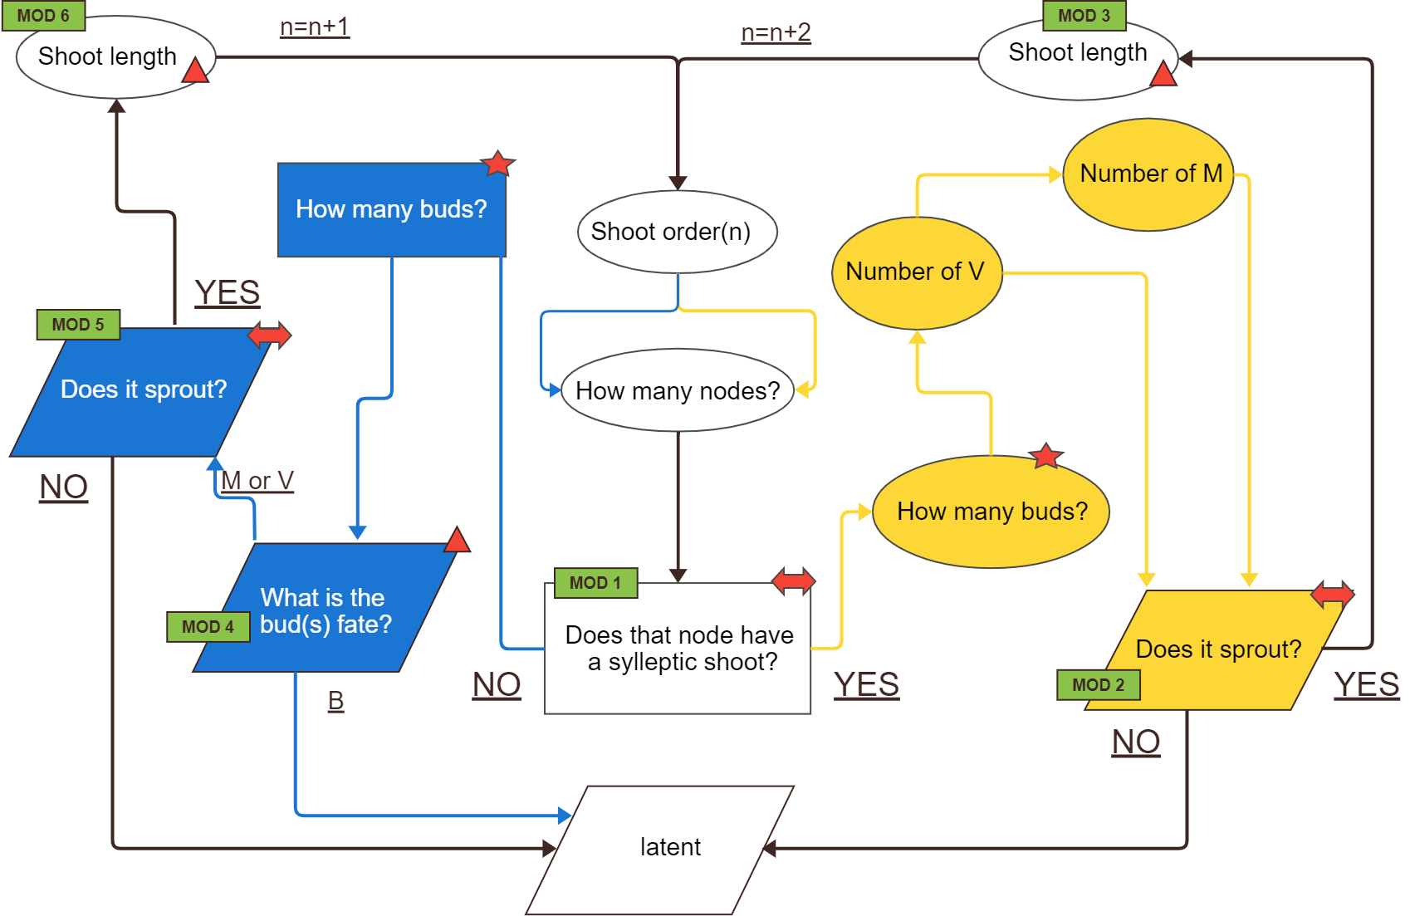
DATA ANALYSES

Slide 9
GLMs
Markovian models
They are used to understand if a predictor describes a variable
Poisson if the variable is quantitative (numeric);
Gaussian if the variable is quantitative (integer);
Binomial if the variable is categorical
They are used to understand if the variables (buds) can be grouped into homogeneus zones.
HAZELNUT ISSUES:
Dependencies between rank nodes;
Dependencies between buds at the same rank

Slide 10
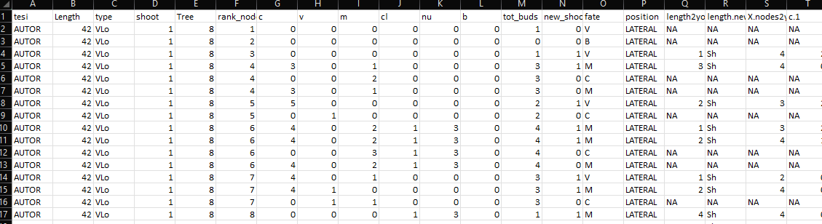
GLMs example
glm(Y~F1+F2+F3+F4+F5+F6+F7, family=«binomial»)
PREDICTORS
Two GLMs:
For fate=V
For fate=M
F1
F2
F3
F4
F5
F6
F7
Y
How to Interpret glm Output in R (With Example) - Statology

Slide 11
Problems & solutions
Several predictors mask their effects (ES. NA values)
Run different GLMs avoid each time a predictor:
Y~tot_buds+length+rank
Y~M+V+C+length+rank
p. Value are significant because we have many data. Is real significance?
Permutation models + difference in AIC

Slide 12
Permutation models
RM=GLMS(Y~A+B+C, data=DF)
Shows that A is really significant (***).
To be more sure that it is really significant, it necessary to do permutation models.
LOGIC:
the AIC of real model (RM= Y~A+B+C) should be LOWER (better) than the null model (NM= Y~B+C+1).
Compute RM-NM=q? YES (q should be <0)
But it could be a casuality. We have to permute A (shuffled) 10000 run again RM_shuf=(Y~A(shuffled)+B+C)
RM_shuf-NM=t
how many times t<q??. If t is < q it means that RM_shuf better explain the model!!!
If t<q in 0.001% of the permuted trials we can conclude that A has an effect on Y!!

Slide 13
Make GLMs
ADDING METHOD
Find dipendent variable (Y) and predictor (A). NB_start with 1 predictor and if it is significant, add the others.
Run the model glm(Y~A)
Is A significant?
No. → Stop. Try another predictor (B);
Yes. → permutation model cofirm?
Find another predictor (B);
Run the glm (Y~A+B)
Is B significant?
No. → stop. Try with another predictor (C);
Yes→permutation model cofirm?
Continue like this with all predictors

Slide 14
Make GLMs
SUBTRACTING METHOD
Find dipendent variable (Y) and predictors (A,B,C). NB_start with ALL predictorS and DISCARD THE LESS SIGNIFICANT USING THE PERMUTATIONS MODEL AND P-VALUE OF GLMS
Run the model glm(Y~A+B+C)
Exclude the predictor less significant
Try different combinations (Y~A+B; Y~A+C, Y~B+C)
An alternative way is to use the function step() with glm. It will automatically check the predictor with lower AIC (step function – Rdocumentation) tutorial in : 2101f11StepwiseLogisticR (toronto.edu)
dredge function – Rdocumentation → function in R that select the best model to fit

Slide 15
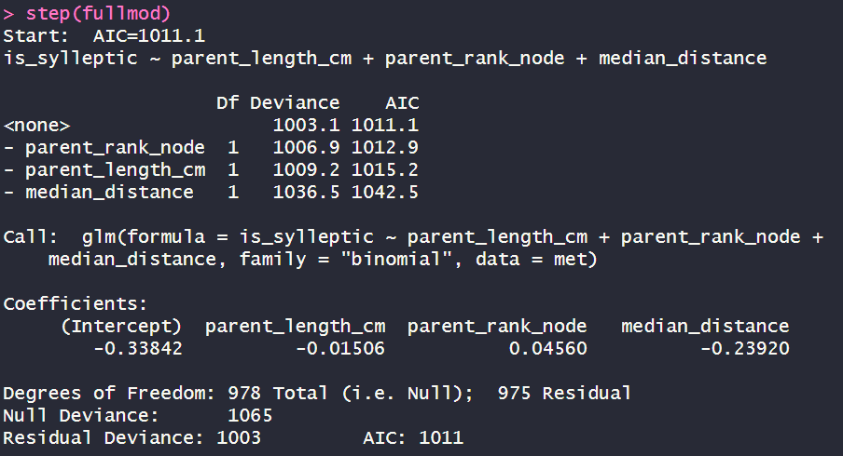
Step()
>fullmod= glm(Y~A+B+C)
>summary(fullmod)→ in questo modo vedi i risultati in termini di Estimate (probabilità, significatività (***) e l’ AIC (più piccolo è meglio è)
Inserendo Mod nella funzione step accade questo:
>step(fullmod)
1. AIC di partenza con tutti e tre i parametri
2. Se il modello mantiene tutti e tre i parametri. L’AIC è 1011.1
3. Se il modello toglie «parent_rank_node». L’AIC è 1012.9 quindi più alto e quindi peggiore
4. Se il modello toglie «parent_length_cm». L’AIC è 1015.2 quindi più alto e quindi peggiore
5. Se il modello toglie «median_distance». L’AIC è 1042.5 quindi più alto e quindi peggiore
Quindi in sostanza, quello con tutti e tre i parametri è il migliore!!

Slide 16
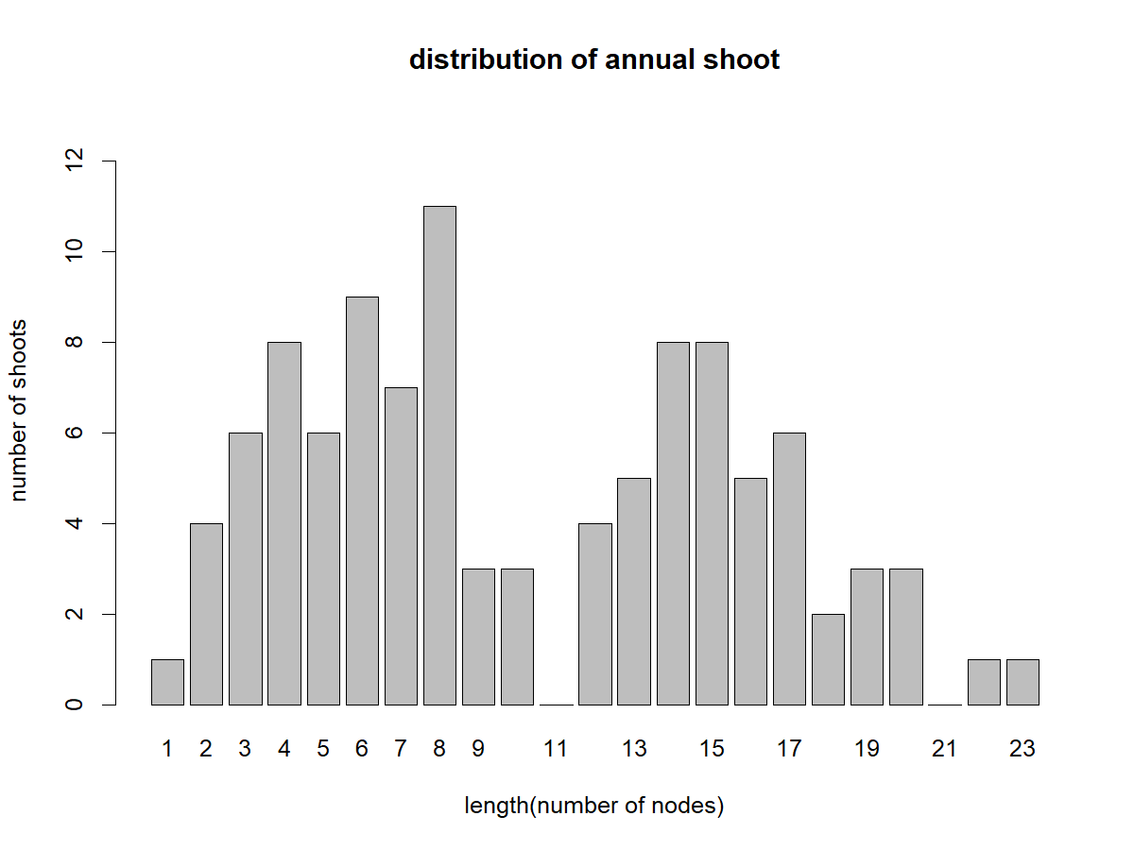
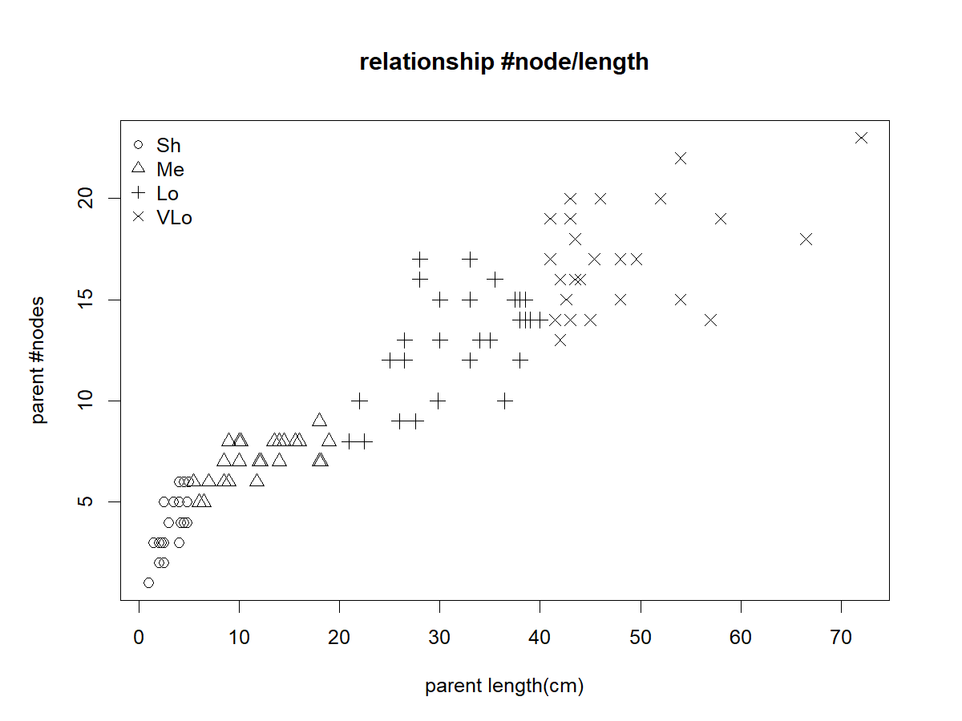
1_ length ~ INVESTIGATE METAMER SCALE_EXPLO
It seems we can group the shoots from into 2 length category: length 2-9 and length 12-17
RELATIONSHIP BETWEEN LENGTH IN CM AND NUMBER OF NODES!

Slide 17
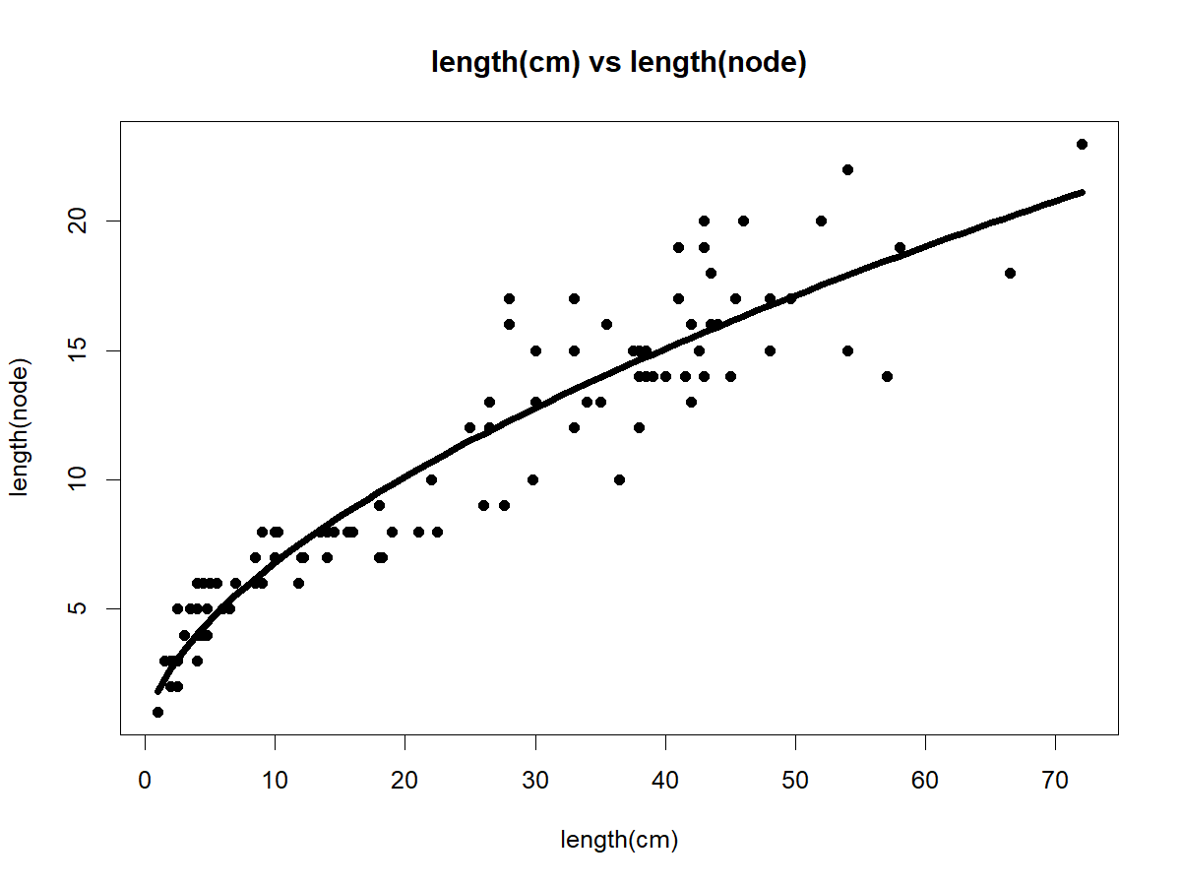
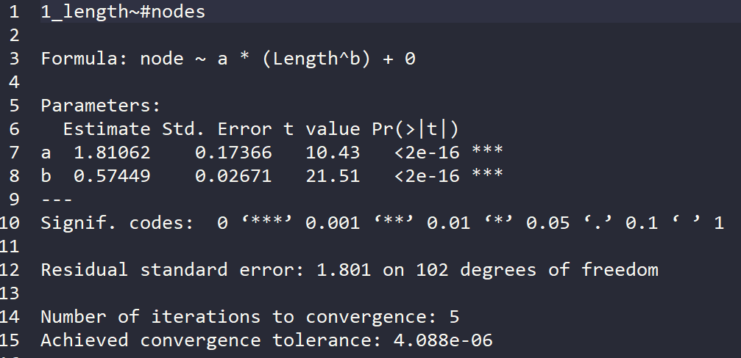
1_ length ~ INVESTIGATE METAMER SCALE_MODEL

Slide 18
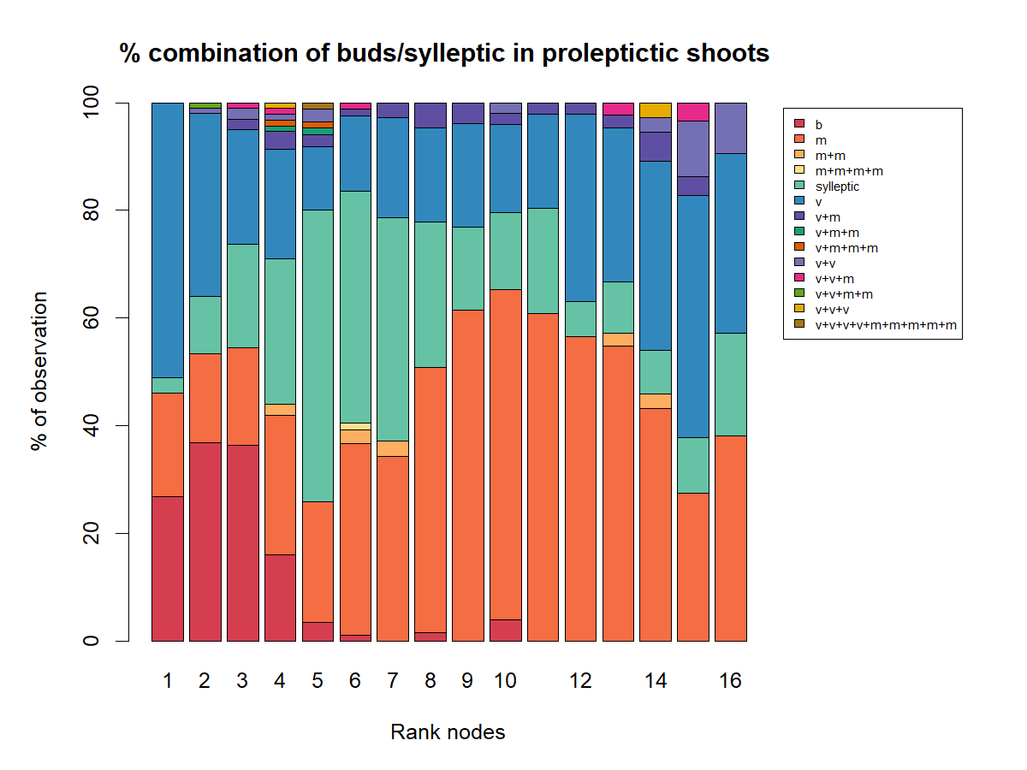
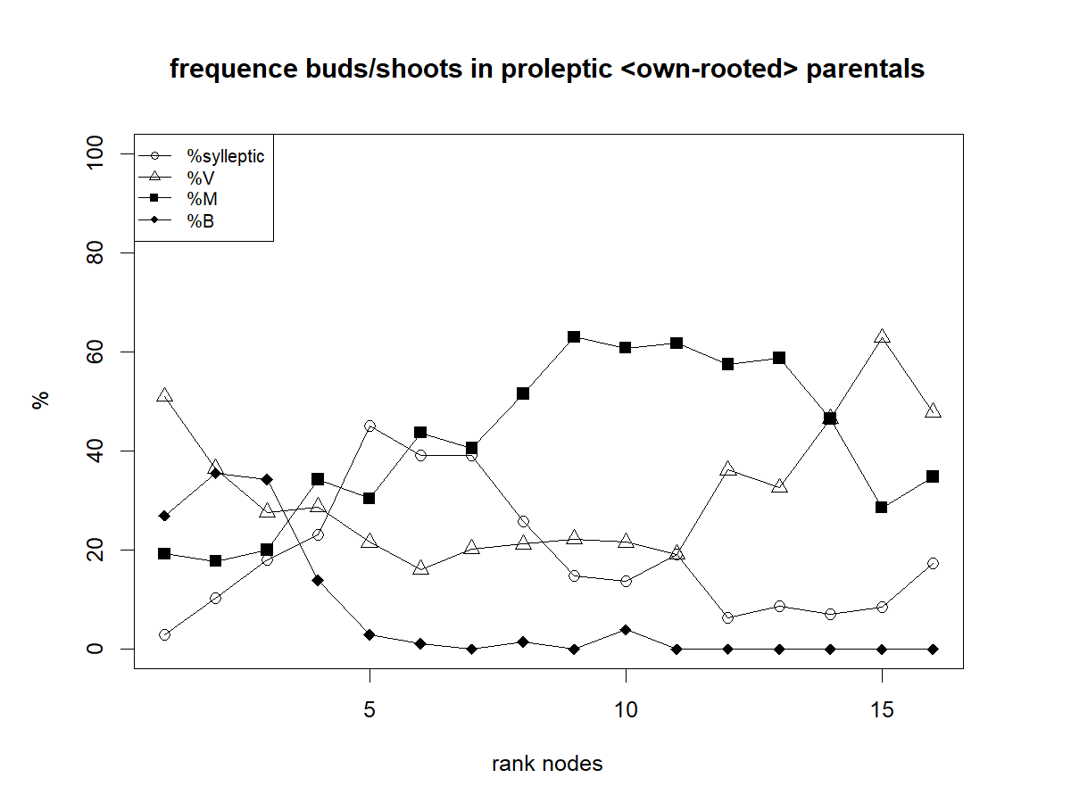
2_ proba having sylleptic: INVESTIGATE METAMER SCALE_MODEL
Because sylleptic are distributed in the median zone along the parent shoot, the rank does not have a linear effect:
we compute for each bud the distance to the shoot extremities,
0 is the median rank of each shoot

Slide 19
2_ proba having sylleptic: INVESTIGATE METAMER SCALE_EXPLO
it seems that sylleptic shoots are more from rank 4 to 8

Slide 20
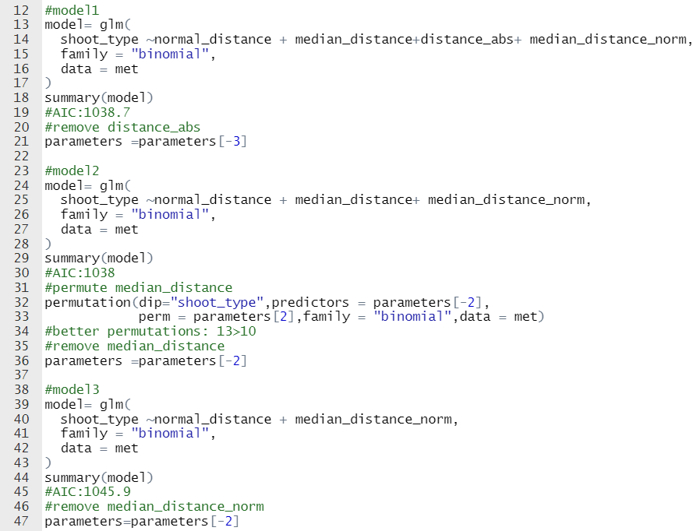
2_ proba having sylleptic: INVESTIGATE METAMER SCALE_MODEL

Slide 21
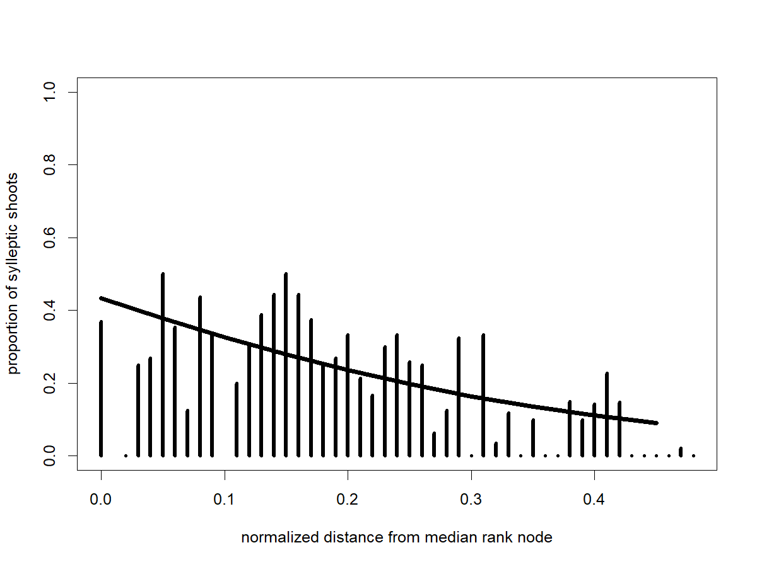
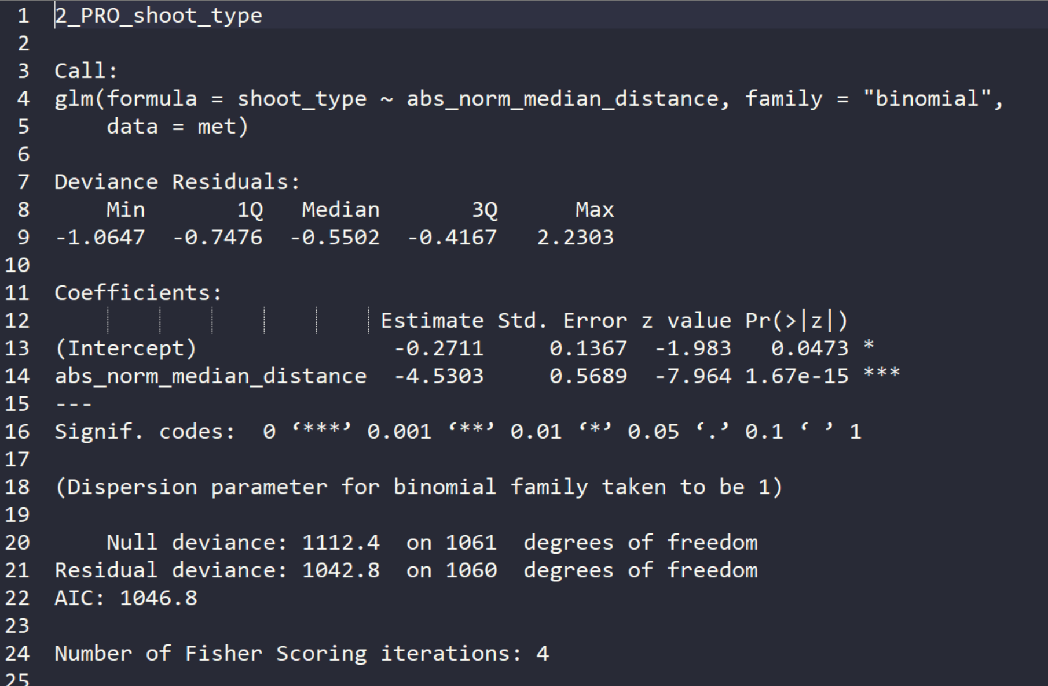
2_ proba having sylleptic: INVESTIGATE METAMER SCALE_MODEL

Slide 22
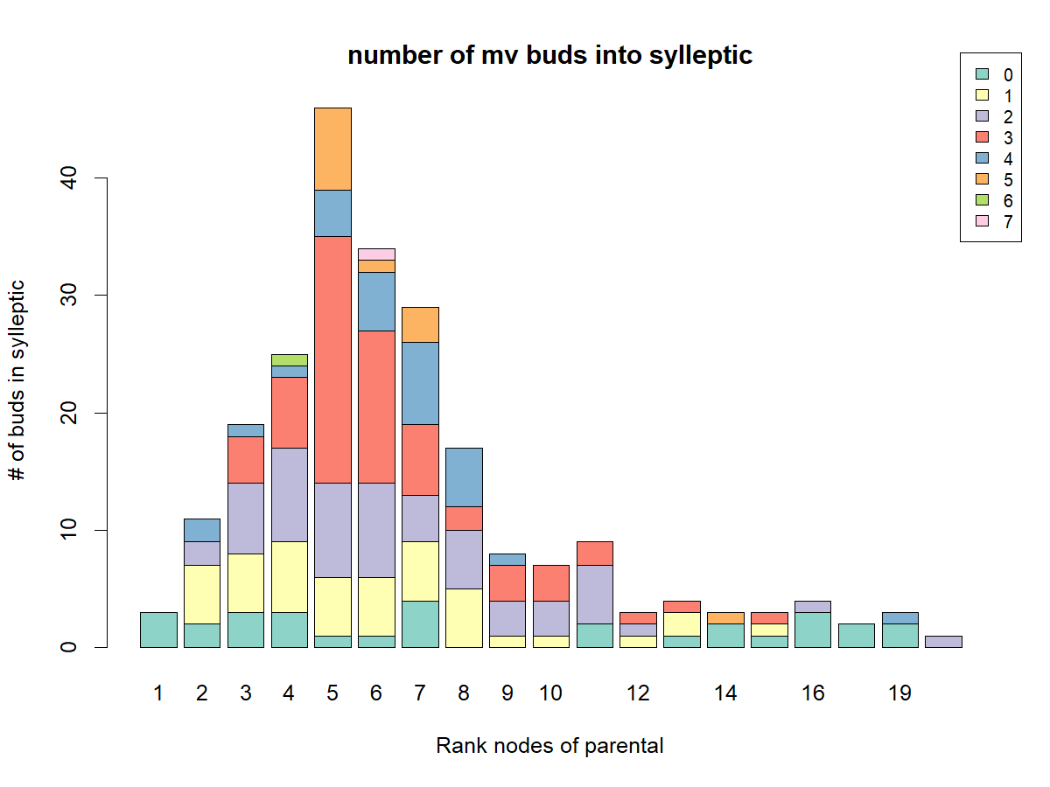
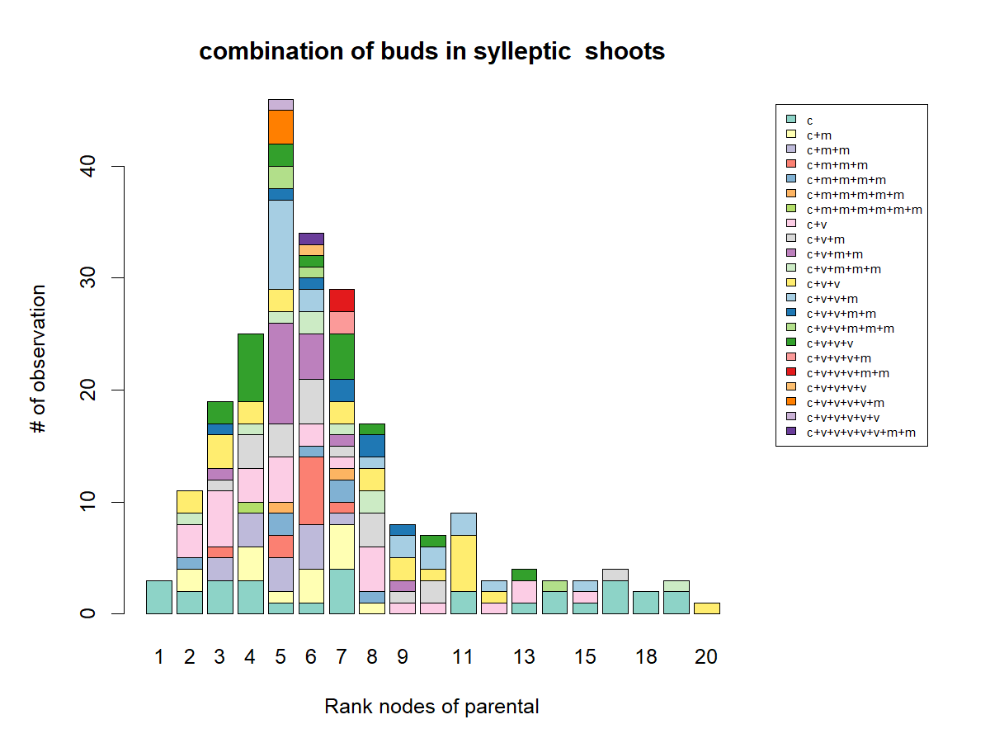
3_ how many buds: INVESTIGATE SHOOT SCALE
There are not so much information on sylleptic but it seems that in the median position there are more buds

Slide 23
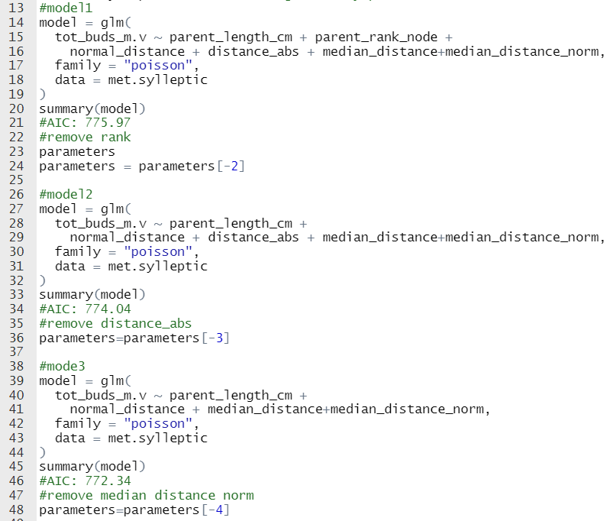
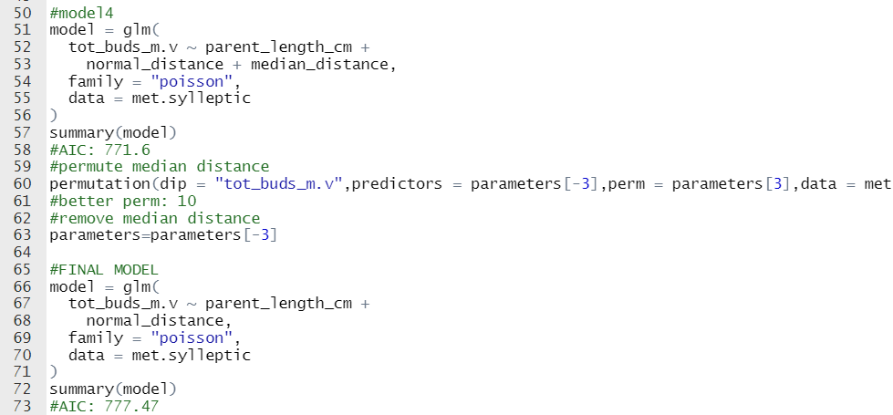
3_ how many buds: INVESTIGATE SHOOT SCALE

Slide 24
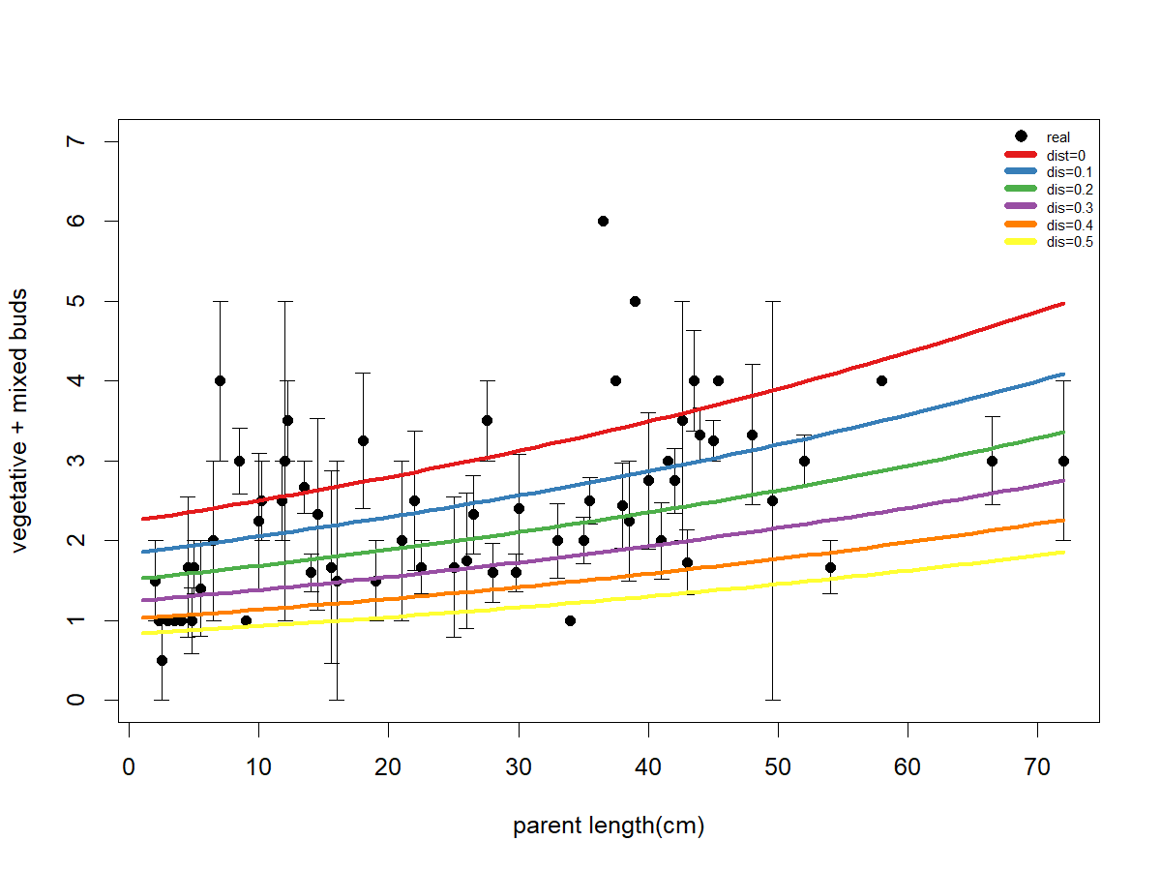
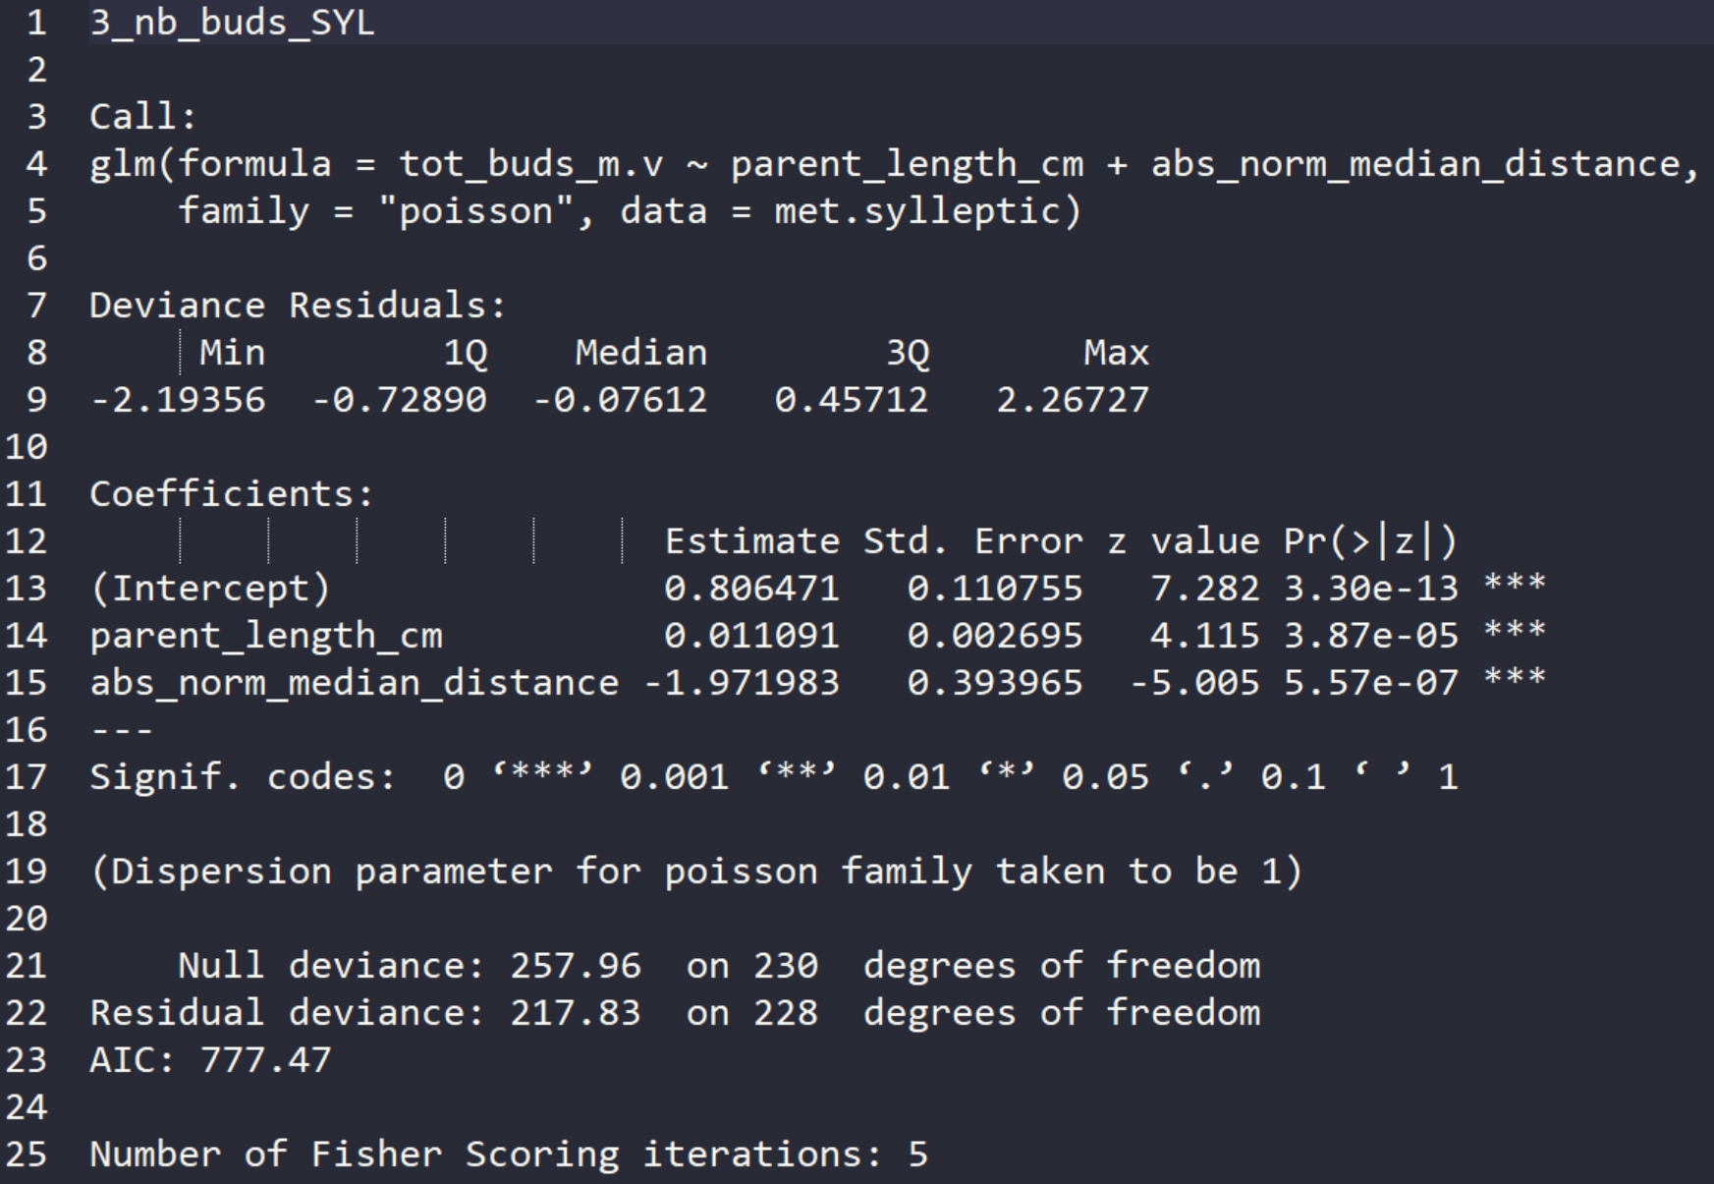
3_ how many buds: INVESTIGATE SHOOT SCALE

Slide 25
3_ how many buds: INVESTIGATE SHOOT SCALE

Slide 26
3_ how many buds: INVESTIGATE METAMER SCALE
It seems that the number of buds it is not related to rank or length of proleptic shoots

Slide 27
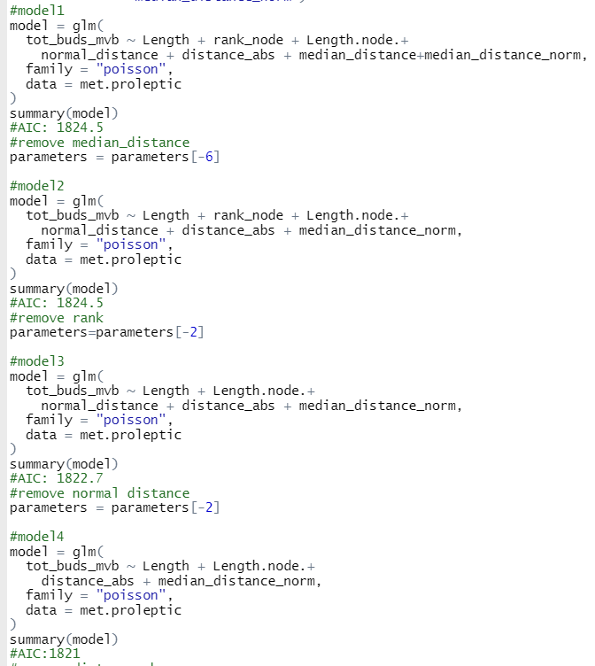
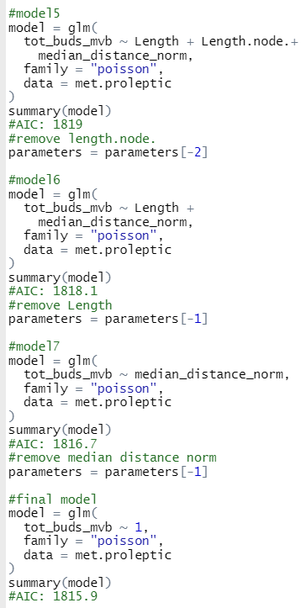
3_ how many buds: INVESTIGATE METAMER SCALE

Slide 28
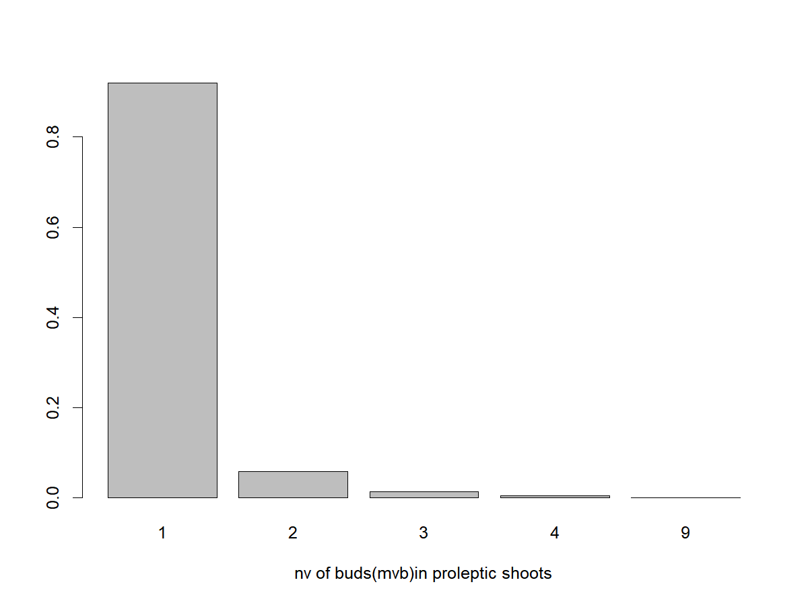
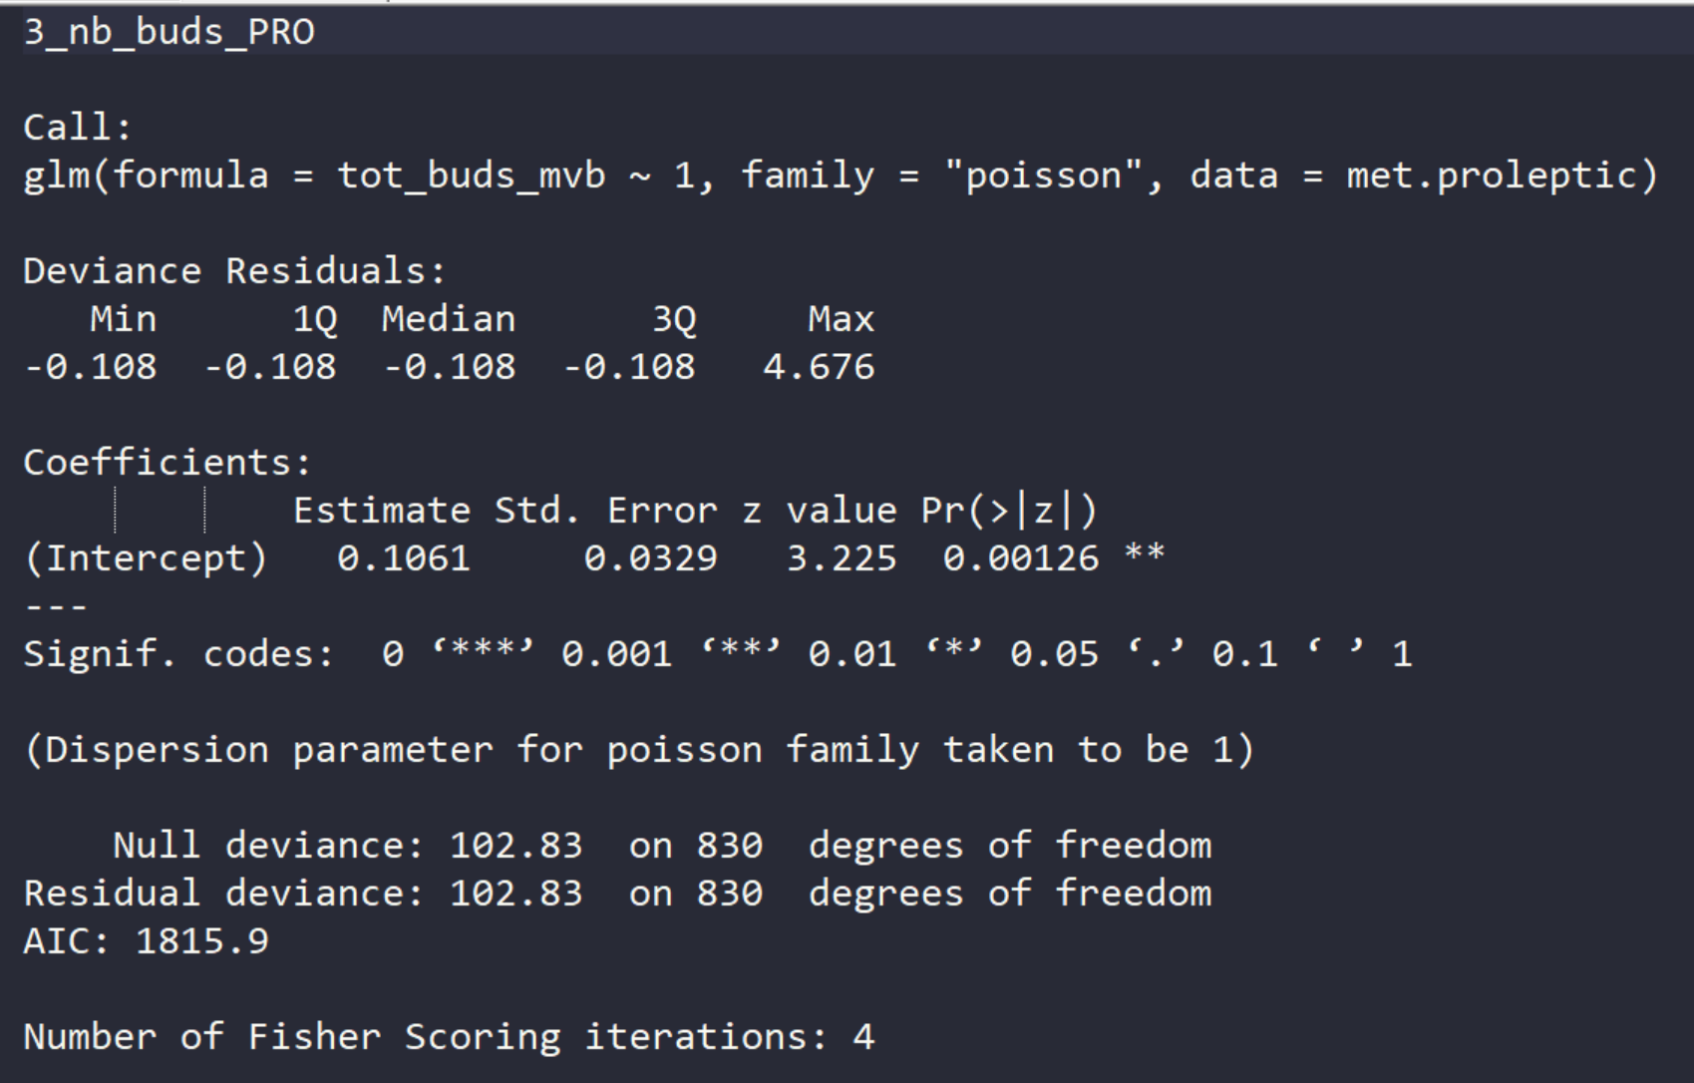
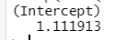
3_ how many buds: INVESTIGATE METAMER SCALE
Exp coef=

Slide 29
4_ M and V proportion: INVESTIGATE SHOOT SCALE
There are not so much information on sylleptic and the proportion of M and V is not statistically different

Slide 30
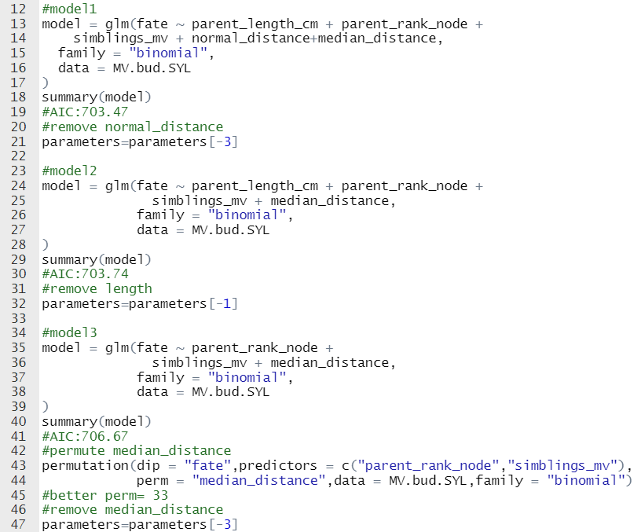
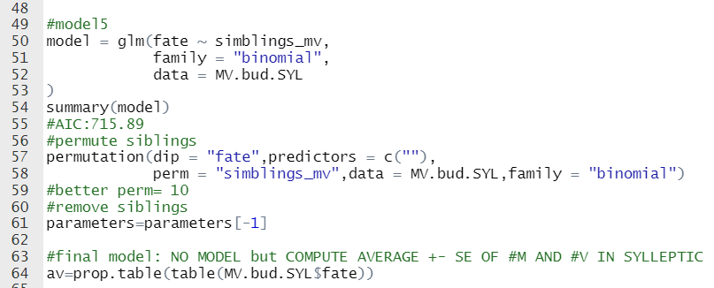
4_ M and V proportion: INVESTIGATE SHOOT SCALE

Slide 31
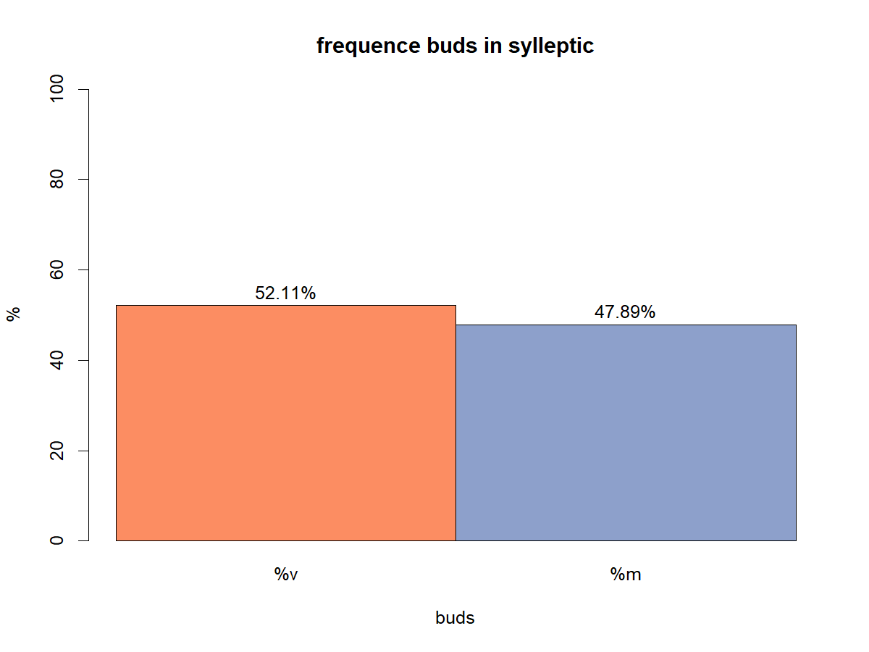
4_ M and V proportion: INVESTIGATE SHOOT SCALE

Slide 32
4_ M and V proportion: INVESTIGATE BUD SCALE
It seems that rank influences the type of bud

Slide 33
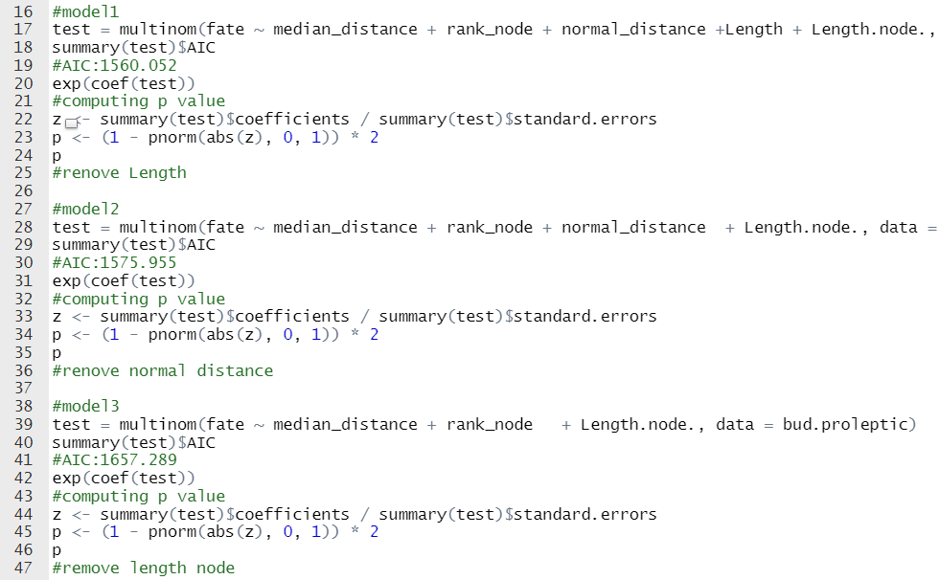
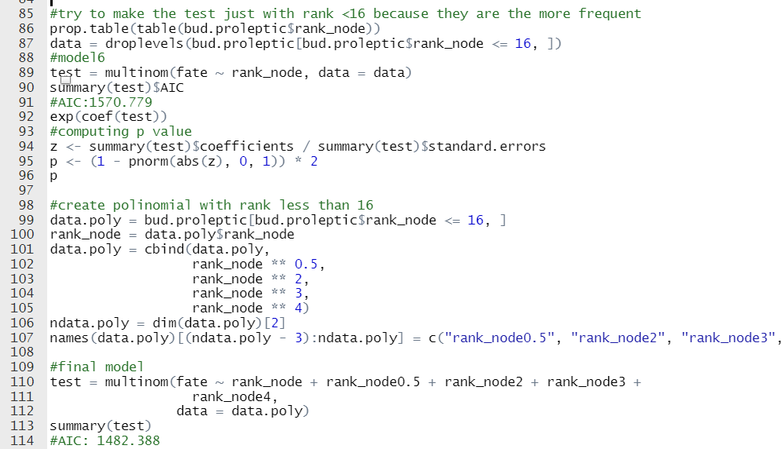
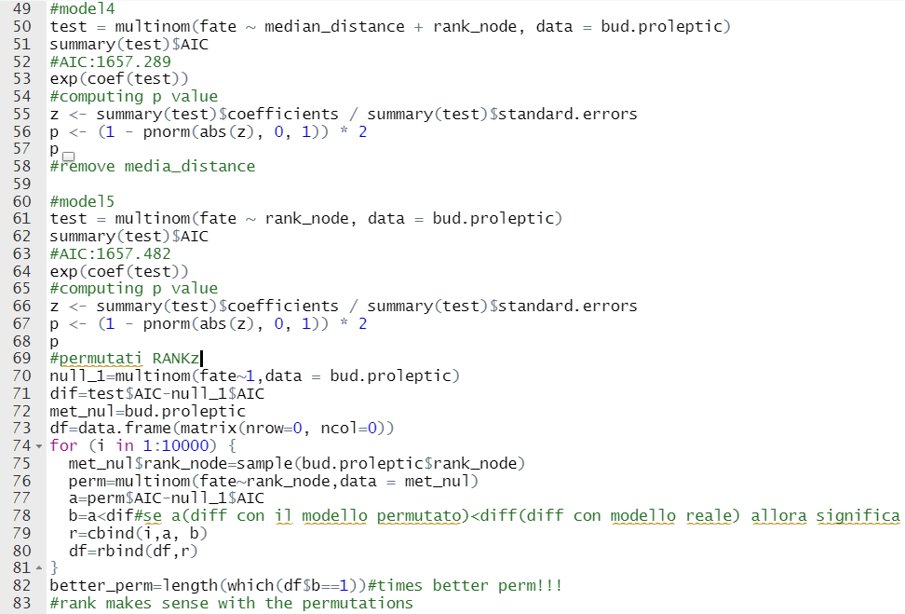
4_ M and V proportion: INVESTIGATE BUD SCALE

Slide 34
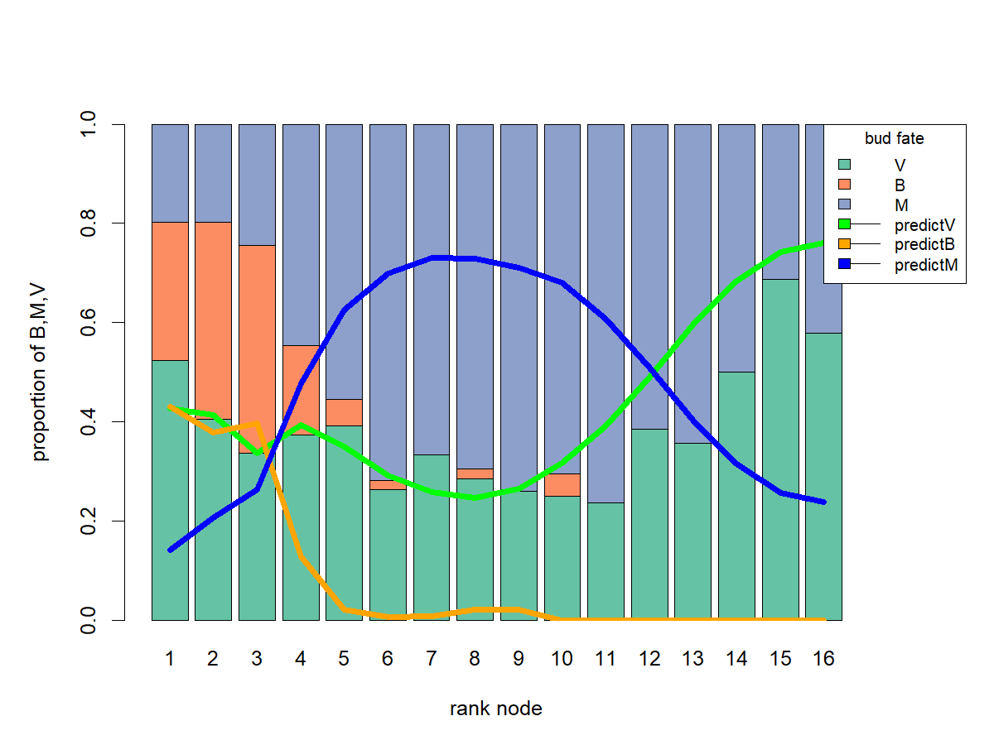
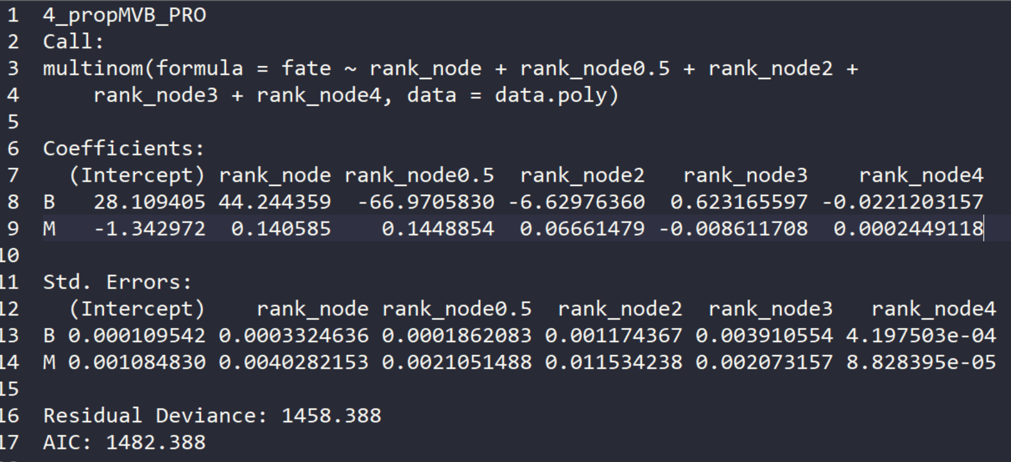
4_ M and V proportion: INVESTIGATE BUD SCALE

Slide 35
5_ probability having new shoots: INVESTIGATE BUD SCALE
maybe the number of other buds or fate or rank

Slide 36
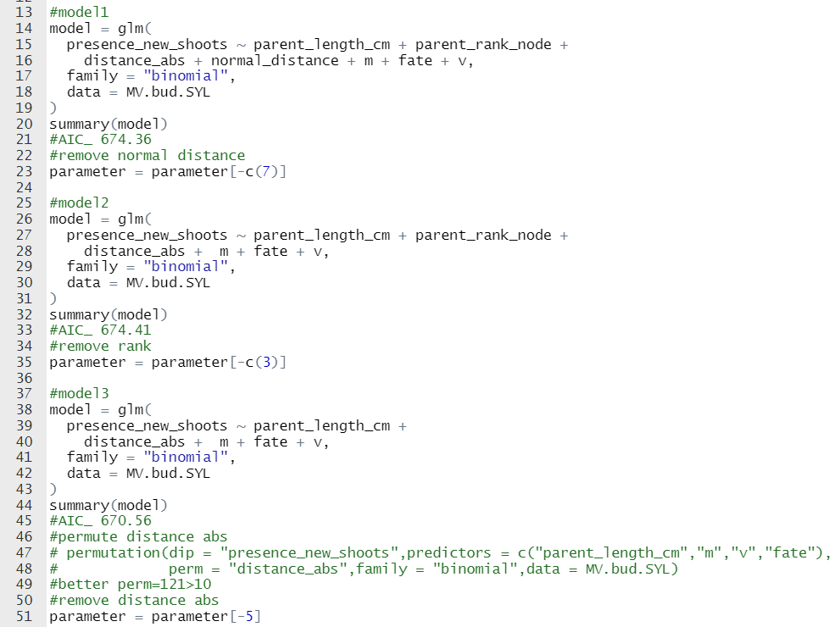
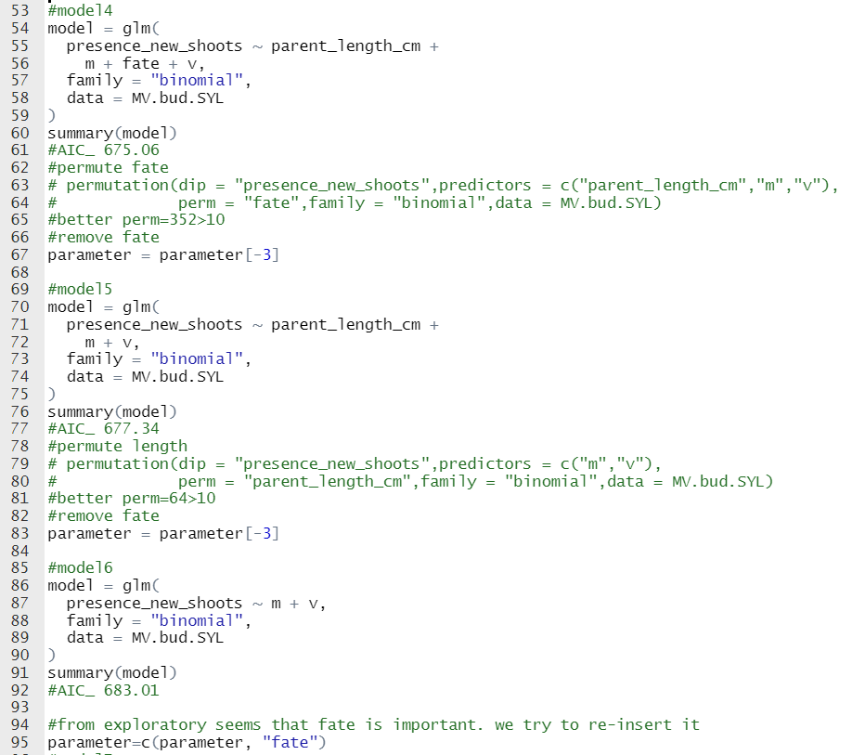
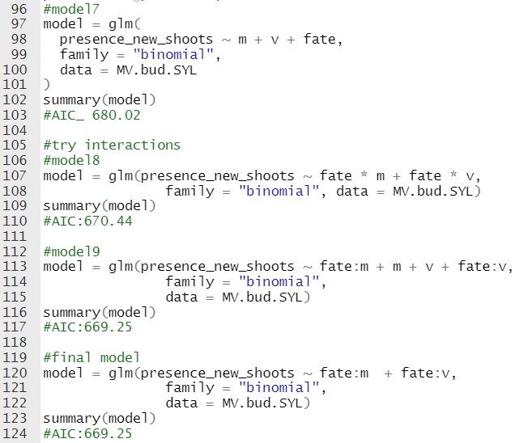
5_ probability having new shoots: INVESTIGATE BUD SCALE

Slide 37
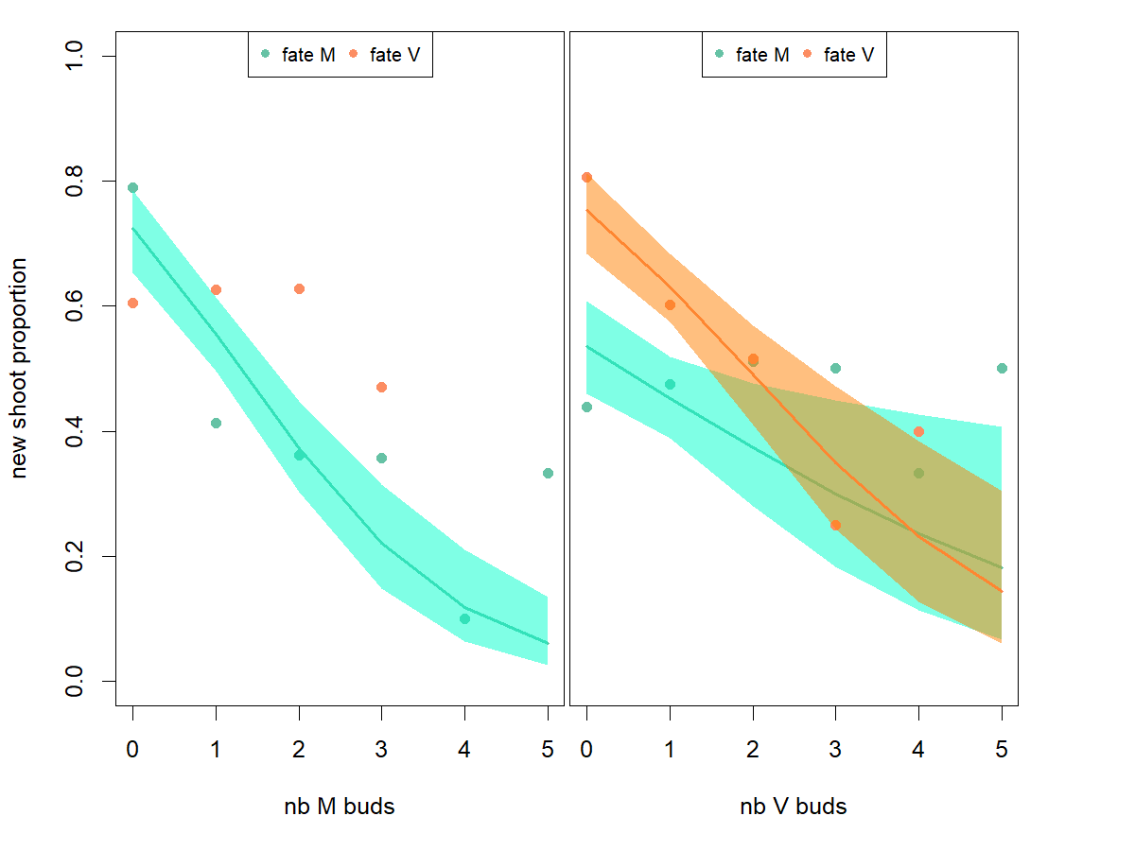
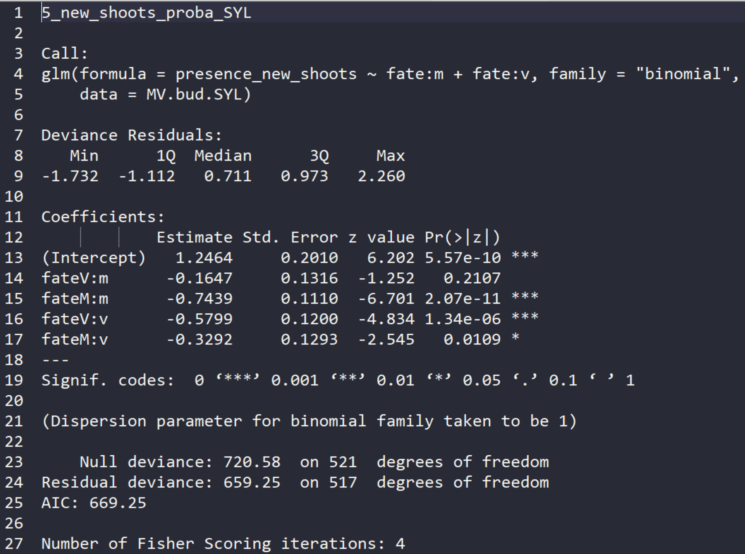
5_ probability having new shoots: INVESTIGATE BUD SCALE

Slide 38
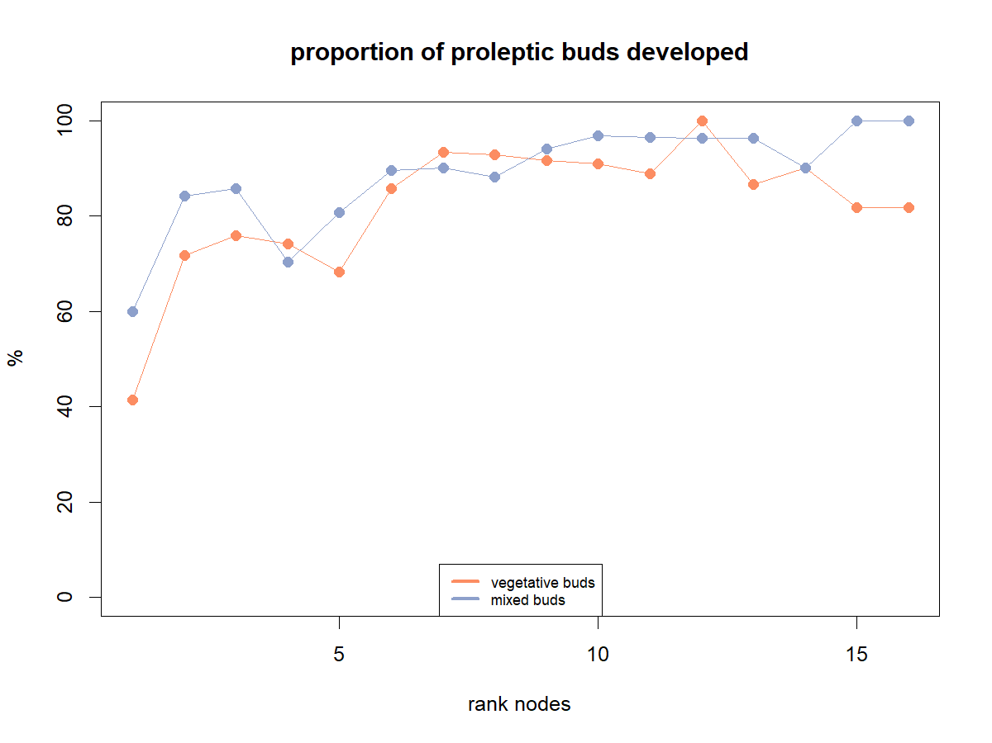
5_ probability having new shoots: INVESTIGATE BUD SCALE
It seems that rank influences the bursting
It seems that the presence of other buds influence bud bursting

Slide 39
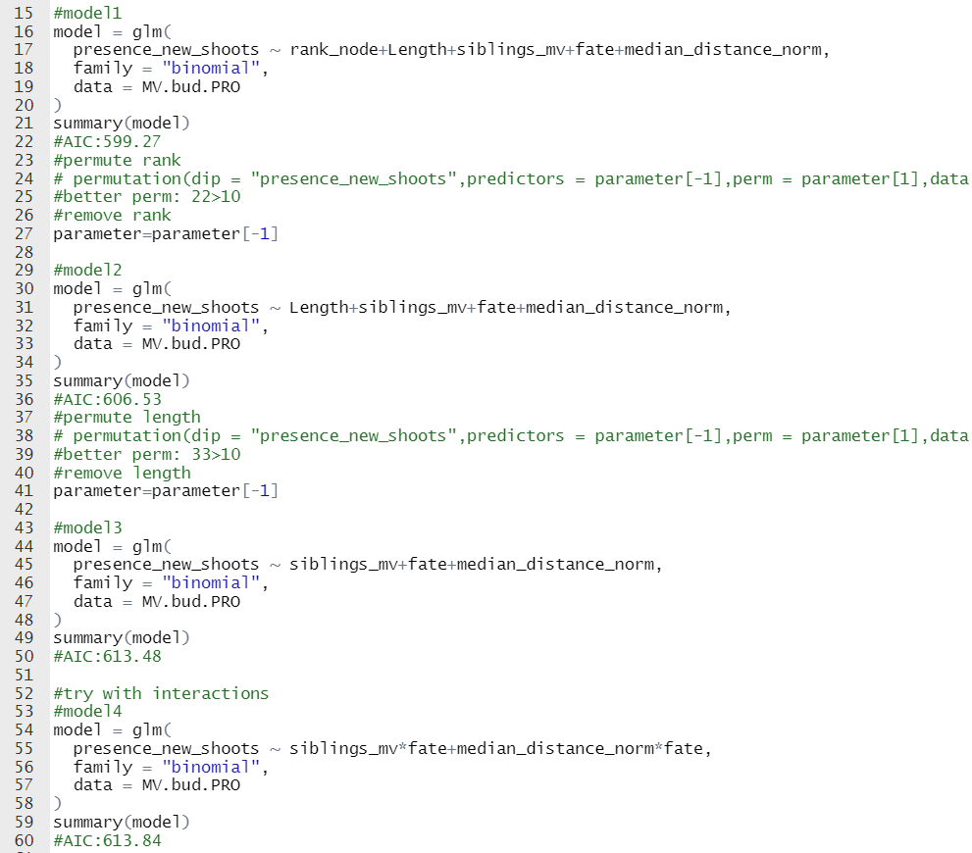

5_ probability having new shoots: INVESTIGATE BUD SCALE

Slide 40


5_ probability having new shoots: INVESTIGATE BUD SCALE

Slide 41
6_ new shoots length: INVESTIGATE SHOOT SCALE
There are not so much information on sylleptic so the shoot length will be computed as a distribution length

Slide 42



6_ new shoots length: INVESTIGATE SHOOT SCALE

Slide 43


6_ new shoots length: INVESTIGATE SHOOT SCALE

Slide 44
6_ new shoots length: INVESTIGATE SHOOT SCALE
It seems that rank influences the length

Slide 45


6_ new shoots length: INVESTIGATE SHOOT SCALE

Slide 46



6_ new shoots length: INVESTIGATE SHOOT SCALE

Slide 47


How many nuts
Bud scale. Taking just M buds (both in sylleptic and proleptic)

Slide 48


Slide 49

1_ length ~ INVESTIGATE METAMER SCALE_MODEL

Slide 50


2_ proba having sylleptic: INVESTIGATE METAMER SCALE_MODEL

Slide 51


3_ how many buds: INVESTIGATE SHOOT SCALE

Slide 52

3_ how many buds: INVESTIGATE METAMER SCALE

Slide 53

4_ M and V proportion: INVESTIGATE BUD SCALE

Slide 54

5_ probability having new shoots: INVESTIGATE BUD SCALE

Slide 55

5_ probability having new shoots: INVESTIGATE BUD SCALE

Slide 56

6_ new shoots length: INVESTIGATE SHOOT SCALE

Slide 57


6_ new shoots length: INVESTIGATE SHOOT SCALE

Slide 58

How many nuts
Bud scale. Taking just M buds (both in sylleptic and proleptic)

Slide 59


Diameter

